Slide 1

Unlocking Climate Finance for Agrifood Systems
The role of blended finance, guarantees, and insurance
Karla D. González Esquinca
November 4th, 2026

Slide 2
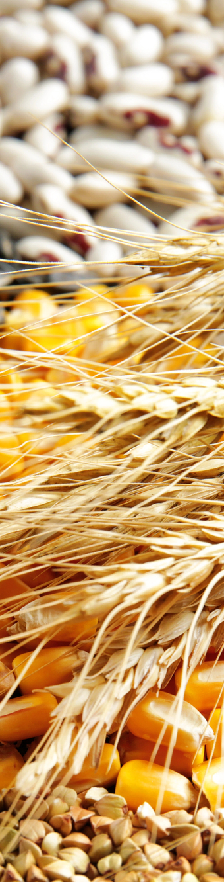
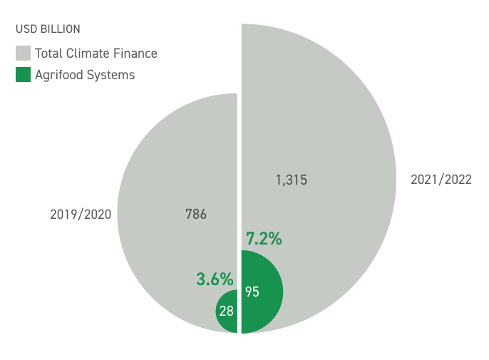
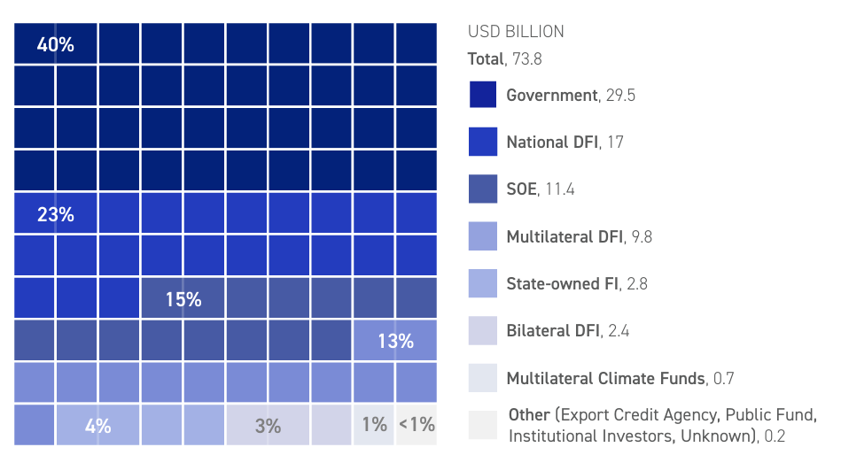
Agrifood systems receive only a fraction of the climate finance they need.
Project-level climate finance to agrifood systems, 2019/20 and 2021/22
Public sources of climate finance for agrifood systems, 2021/22
Source: CLIC, 2025. Landscape of Climate Finance for Agrifood Systems 2025.
Source: CLIC, 2025. Landscape of Climate Finance for Agrifood Systems 2025.

Slide 3
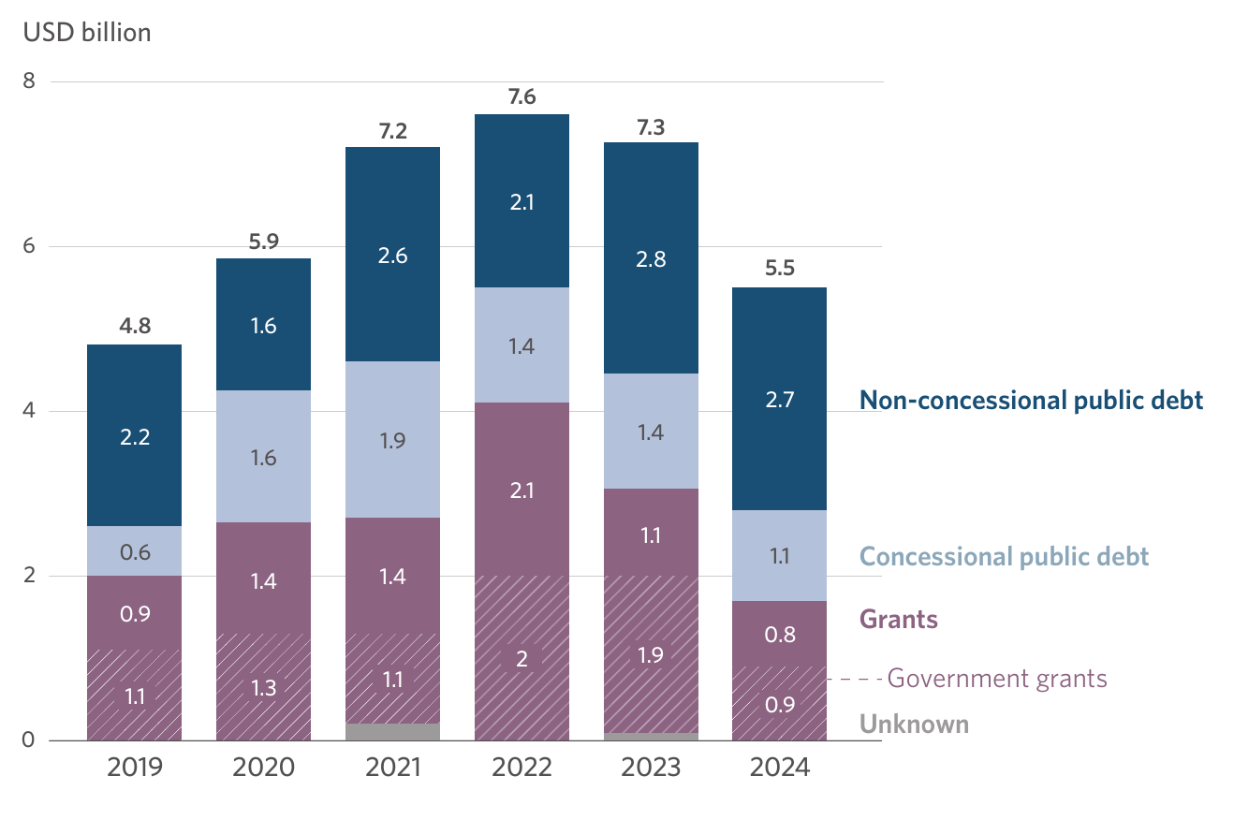
Adaptation finance is declining, and the financing mix is changing
Adaptation finance to AFOLU by instruments, with government grant provision
AFOLU adaptation finance has shifted from grants to debt. Grant finance has markedly declined from USD 4.1 billion in 2022 to USD 1.7 billion in 2024. Over the same period, debt-based instruments—primarily non-concessional loans and bonds— have trended upward.
The transition toward repayable finance increases the importance of risk-sharing instruments, but concessional support remains essential for vulnerable producers.
Source: Climate Policy Initiative. 2026. Global Landscape of Climate Finance 2026.
Notes:
Royalty-free, external photo sources

Slide 4
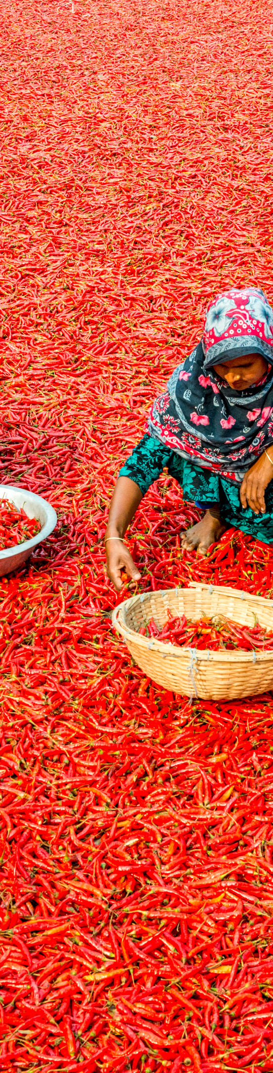
Agrifood systems receive only a fraction of the climate finance they need.
USD 17.9bn
Blended finance to agriculture, 2014–2023
Only 8.4% of total tracked blended finance
2.12× vs. 3.6×
Average private capital leverage
Adaptation vs. mitigation blended finance deals
Public finance
Public goods without commercial revenue models.
Blended finance
High-impact investments with limited returns or high perceived risks
Private finance
Commercially viable, revenue-generating investments.
Combining concessional capital, guarantees, insurance and technical assistance can improve risk-return profiles and unlock investment.

Slide 5
De-risking instruments can unlock investment by addressing different barriers
Guarantees
Insurance
Mitigate credit and default risk, helping Banks lend to underserved farmers and agricultural SMEs.
Protect against climate related shocks, helping stabilize income and borrowers’ repayment capacity.
Concessional capital
Reduces implementation risks and strengthens producers’ capacity and financial performance
Technical assistance
Improves investment terms or absorbs risks that commercial investors are unwilling to take.
Blended finance works best when instruments are combined to address the specific risks preventing investment.

Slide 6

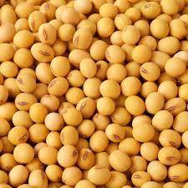
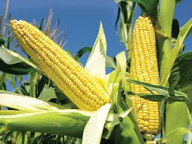

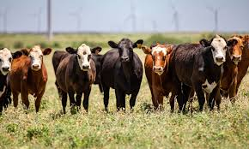
The Goal
  Design and implement an RA fund, to support farmers transitioning to regenerative agriculture, specifically in the soy, corn, coffee, and cattle sectors.
  The fund will build on BDMG’s LabAgroMinas Program to unlock wider financing for the sector and scale RA practices and its resulting socio-economic and environmental benefits.
  The pilot phase of the instrument will focus on coffee producers.

Slide 7
Instrument Structure & Risks Covered
1
2
3
4
What
it is
Tailor Credit Lines
BDMG offers regenerative agriculture credit lines (SoloMais and Bioinsumos) through credit cooperatives, ensuring structured and regionally accessible financing.
Credit Guarantee
The guarantee will de-risks cooperative lending, enabling transition-oriented credit. The facility will promote gender equity by offering up to 100% coverage for women and up to 80% for men.
Technical Assistance
Farmers and technical staff will receive workshops and continuous mentoring to support effective implementation, monitoring, and evaluation of RA practices.
Production Support Fund
A conditional income buffer is activated under predefined triggers to mitigate temporary productivity losses during transition such as proven crop failure.
Risks
covered
Limited access to transition-aligned financing
Rigid conventional structures
Perceived default risk during transition
High collateral barriers
Technical and implementation risks
Knowledge gaps
Operational and cultural resistance.
Short-term income volatility risk
Early-stage yield volatility.

Slide 8
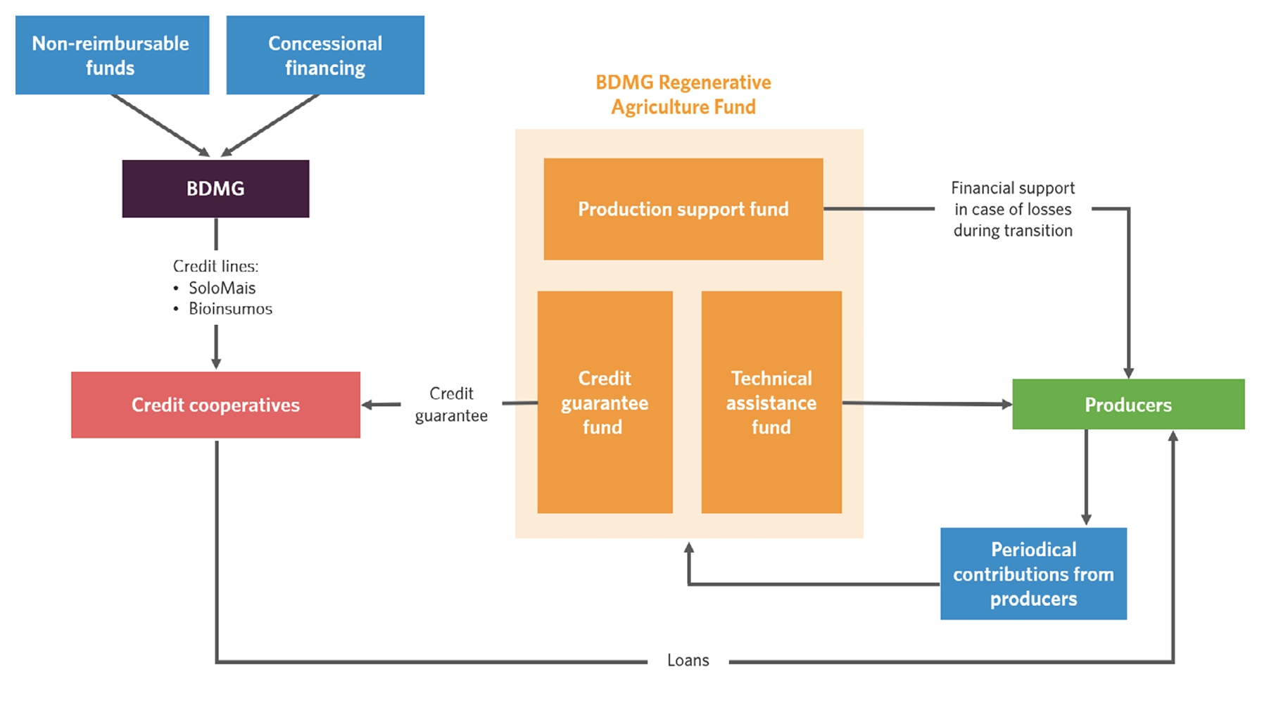
RA Fund: Instrument Mechanics

Slide 9
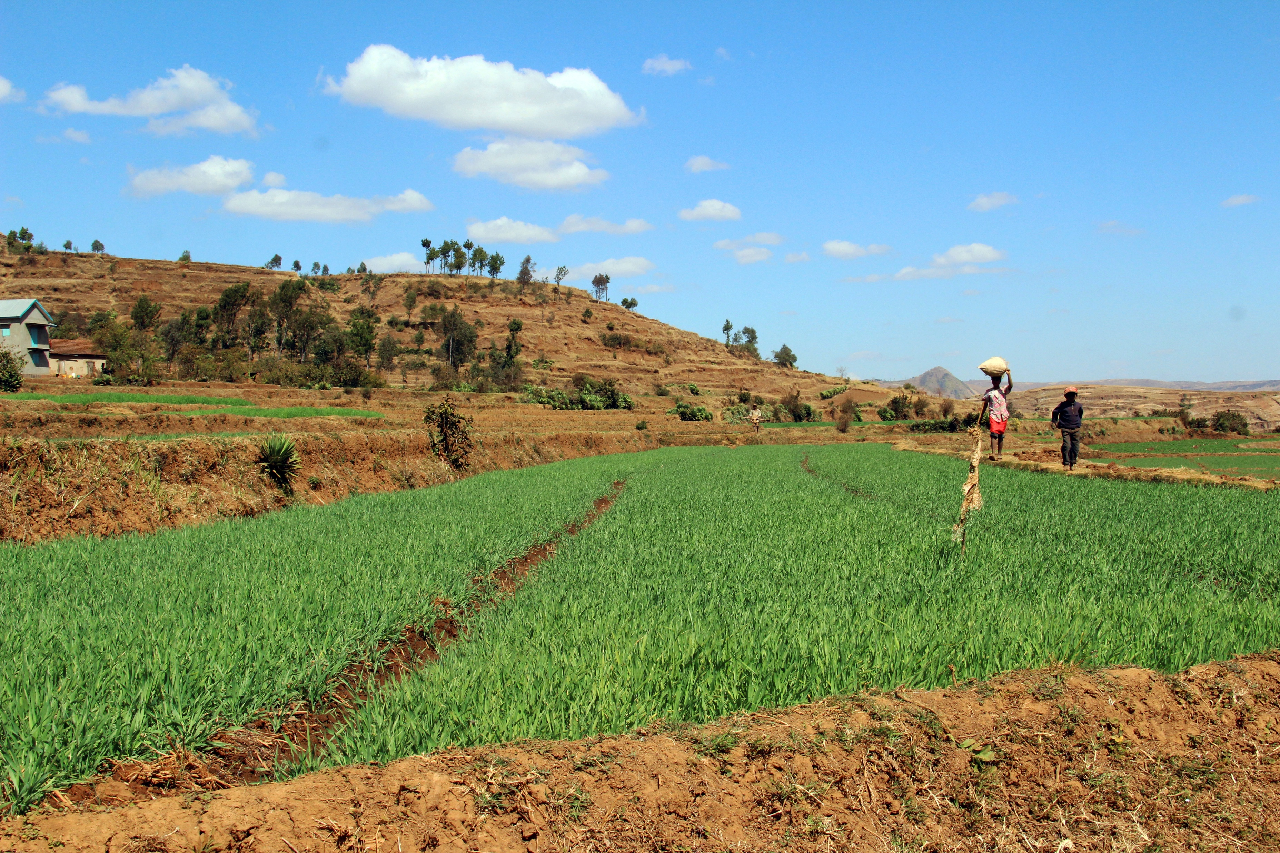
From innovation to scale: How can PDBs unlock private capital for agrifood systems?
AI & other tools
1
Identify market gaps and priority risks
Target the specific barriers preventing investment across agricultural value chains.
2
Structure integrated financing solutions
Combine guarantees, insurance, concessional capital, and technical assistance according to local needs.
3
Build partnerships to scale
Collaborate with local lenders, cooperatives, MDBs, and development partners to mobilise resources and expand reach.

Slide 10
Karla.Esquinca@cpiglobal.org
Notes:
Optional: add your individual contact info

