Slide 1


1
IFAD’s Partial Credit Guarantee (PCG) Pilot:
Catalyzing Private Capital for Rural Development

Slide 2




IFAD PCGs:
Bridging the rural financing gap…
by leveraging IFAD’s…
Persistent and widening gap
Unlocking
private capital
Rising
agri-PDB
demand
Longstanding sectoral expertise
Solid financial capacity
Mismatch between rising rural investment needs and available financing.
Need to scale up concessional finance via tailored mechanisms.
G20 urges MDBs/IFIs to catalyze private capital through risk-sharing instruments.
Private investors show interest in addressing the gap.
Member States request innovative solutions (eg. risk-sharing and technical assistance) to empower agri-PDBs.
Agri-PDBs constrained by market access and capacity gaps in project design, risk mitigation, governance, etc.
Strong track record in structuring bankable rural projects.
Deep expertise in fiduciary oversight, safeguards, and results management.
Leadership of a global agri-PDB coalition (96 countries).
Recognized by IFAD’s AA+ credit rating.
Strong capital and liquidity indicators.
Opportunity to expand product base beyond loans and grants.

Slide 3


PCGs Pilot Program: A Strategic Risk Appetite & Progressive Rollout
Time Horizon
April 2026 – June 2029.
Pilot Scope
A total envelope of US$ 130 million, limited to 1-3 transactions.
Country and Borrower Eligibility
Use of Proceeds
  Support a public sector project, programme, or multiphase programme (policy-based operations and NSOs excluded);
  Fully align with IFAD’s mandate and development agenda for rural transformation;
  Link to IFAD’s AEI, COSOPs, core indicators, and targeting policy;
  Usually support IFAD regular operations during pilot.
Extended to IFAD Member States and their subnational entities, including national development banks;
In countries of all income categories with a focus on LICs and LMICs (excluding countries in or at high risk of debt distress).
Requires a sovereign guarantee through a counterindemnity arrangement.

Slide 4
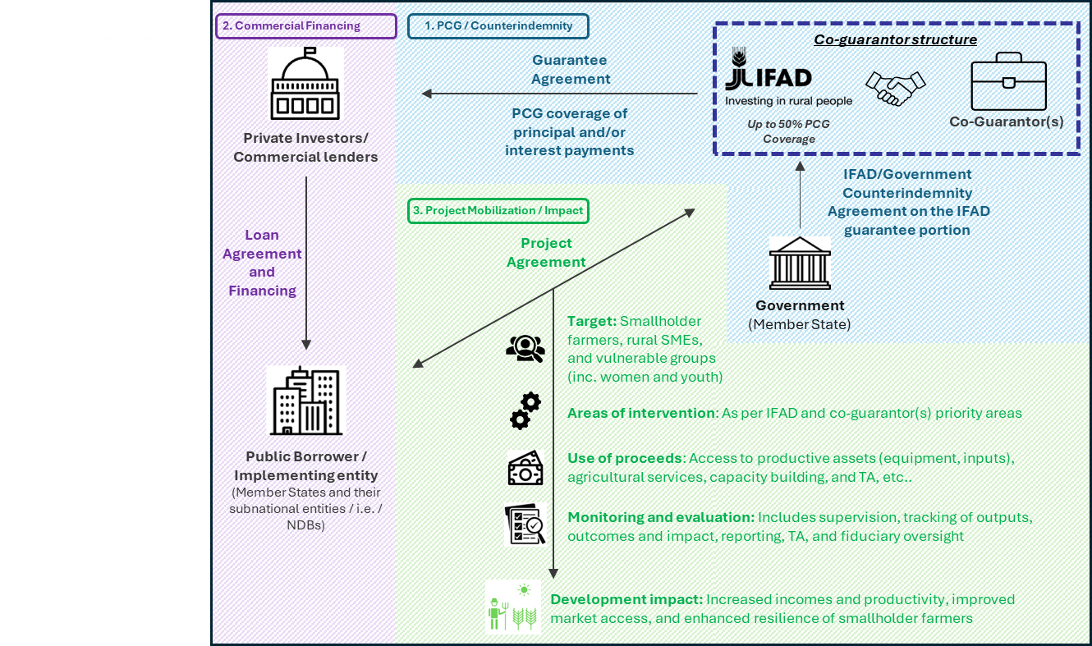
Illustration of Structure
IFAD allocates $25m in guarantee (30% of underlying loan described below); preferably matched by $25m from another guarantor.
A commercial bank then lends $85m to a National Development Bank (NDB), expanding financing by 70% with more favorable terms.
IFAD requires a counterindemnity from the country government to ensure IFAD is repaid for any PCG payouts and preserve its Preferred Creditor Status.
The NDB invests the proceeds in projects that align with IFAD’s mandate and development agenda.

Slide 5




What are the advantages of using PCGs for borrowers?
Offer volume/cost options:
Attracts capital blending concessional and commercial lending terms.
PCGs amplify development impact by…
Catalyzing additional public and private capital.
Helping bridge the rural financing gap as ODA declines.
Enabling scalable, high-impact operations.
Empowering local financial institutions to serve rural communities.
Deeper domestic financial market: Encourages competition and lending in local currencies.
Enhanced national capacity: Supports NDB/PDBs and rural finance system with technical assistance.
Greater scale: Deliver larger, more efficient operations for smallholder farmers and resilient rural systems.

Slide 6
Key Parameters
    General Features
Limited to credit risk guarantee; does not cover political, maturity, off-take, performance, policy-based, or commodity price risks.
Rolling, non-reinstatable, non-accelerable, irrevocable and payable on demand.
Risk-sharing co-guarantee arrangements recommended with MDBs, IFIs, or insurance providers through flexible structures, including pari passu or first/second loss.
Allocated to countries through the PBAS and BRAM mechanisms.
      Terms & Conditions
Types of financial instruments covered: Bilateral and syndicated loans, private placement.
Coverage: IFAD will cover up to 50% of the underlying guaranteed debt instrument.
Currency: USD or EUR.
Tenor: Up to 15 years with a maximum average maturity of 10 years.
Fee structure: Front end fee + commitment fee + guarantee fees (determined on a risk basis).

Slide 7
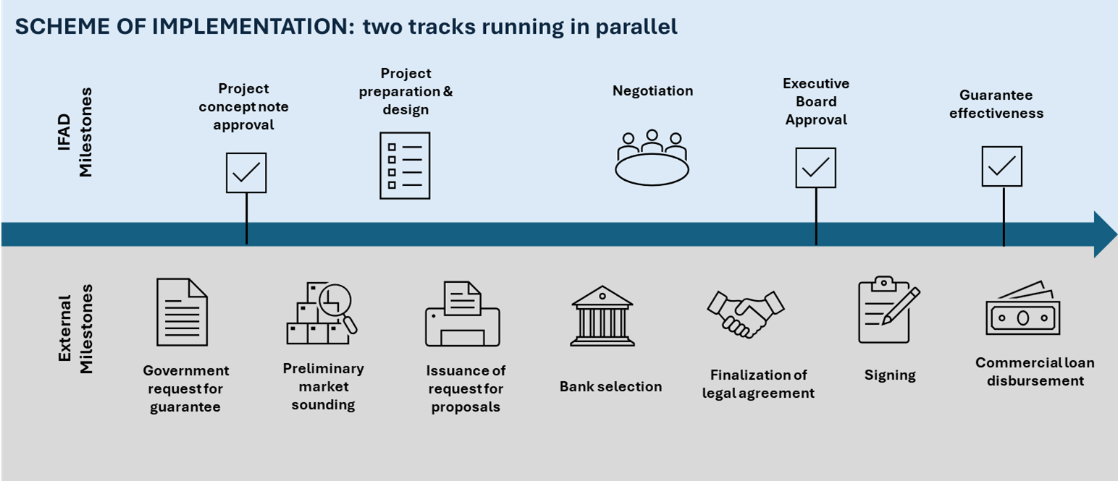
Scheme of Implementation
PCG-funded projects:
Follow IFAD’s regular project cycle, procedures and governance standards including EB approval.
Apply IFAD’s existing requirements on fiduciary oversight, SECAP, mainstreaming and results reporting.

Slide 8
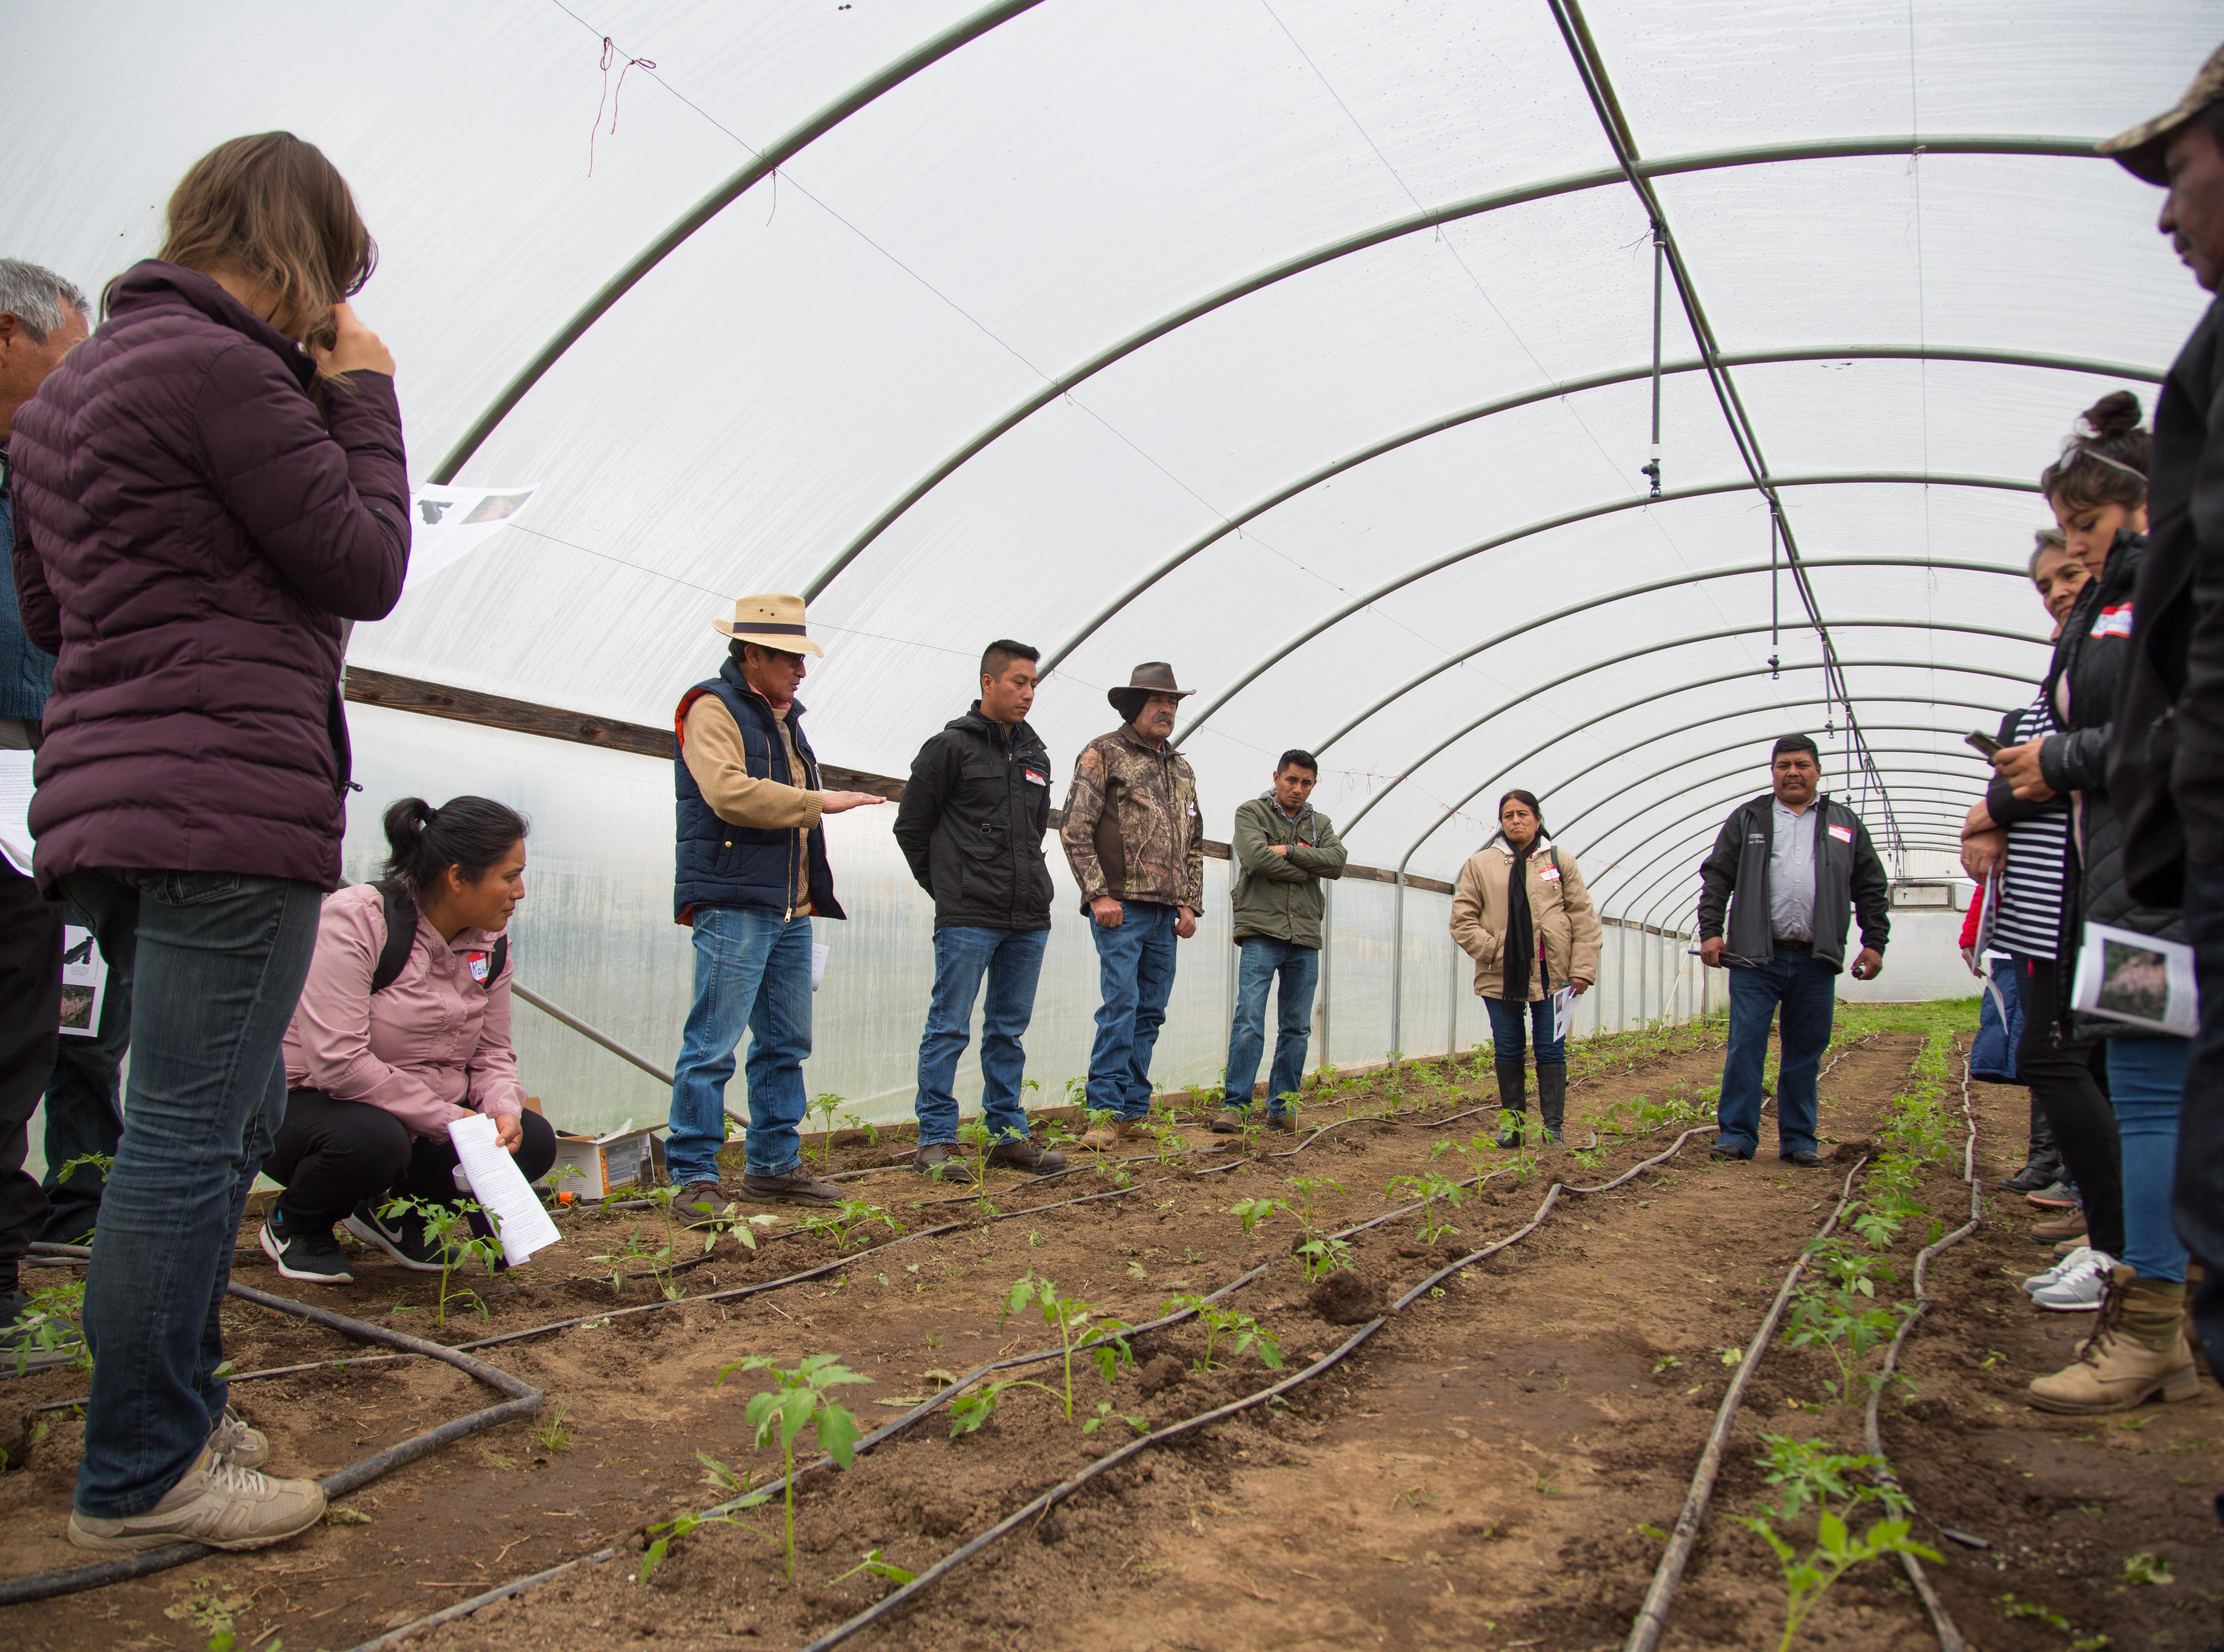
CONTACTS
Malek Sahli
IFAD- Lead Development Finance Officer
m.sahli@ifad.org
Sara Musa
IFAD- Development Finance Officer (Innovative Finance)
s.musa@ifad.org

