Slide 1

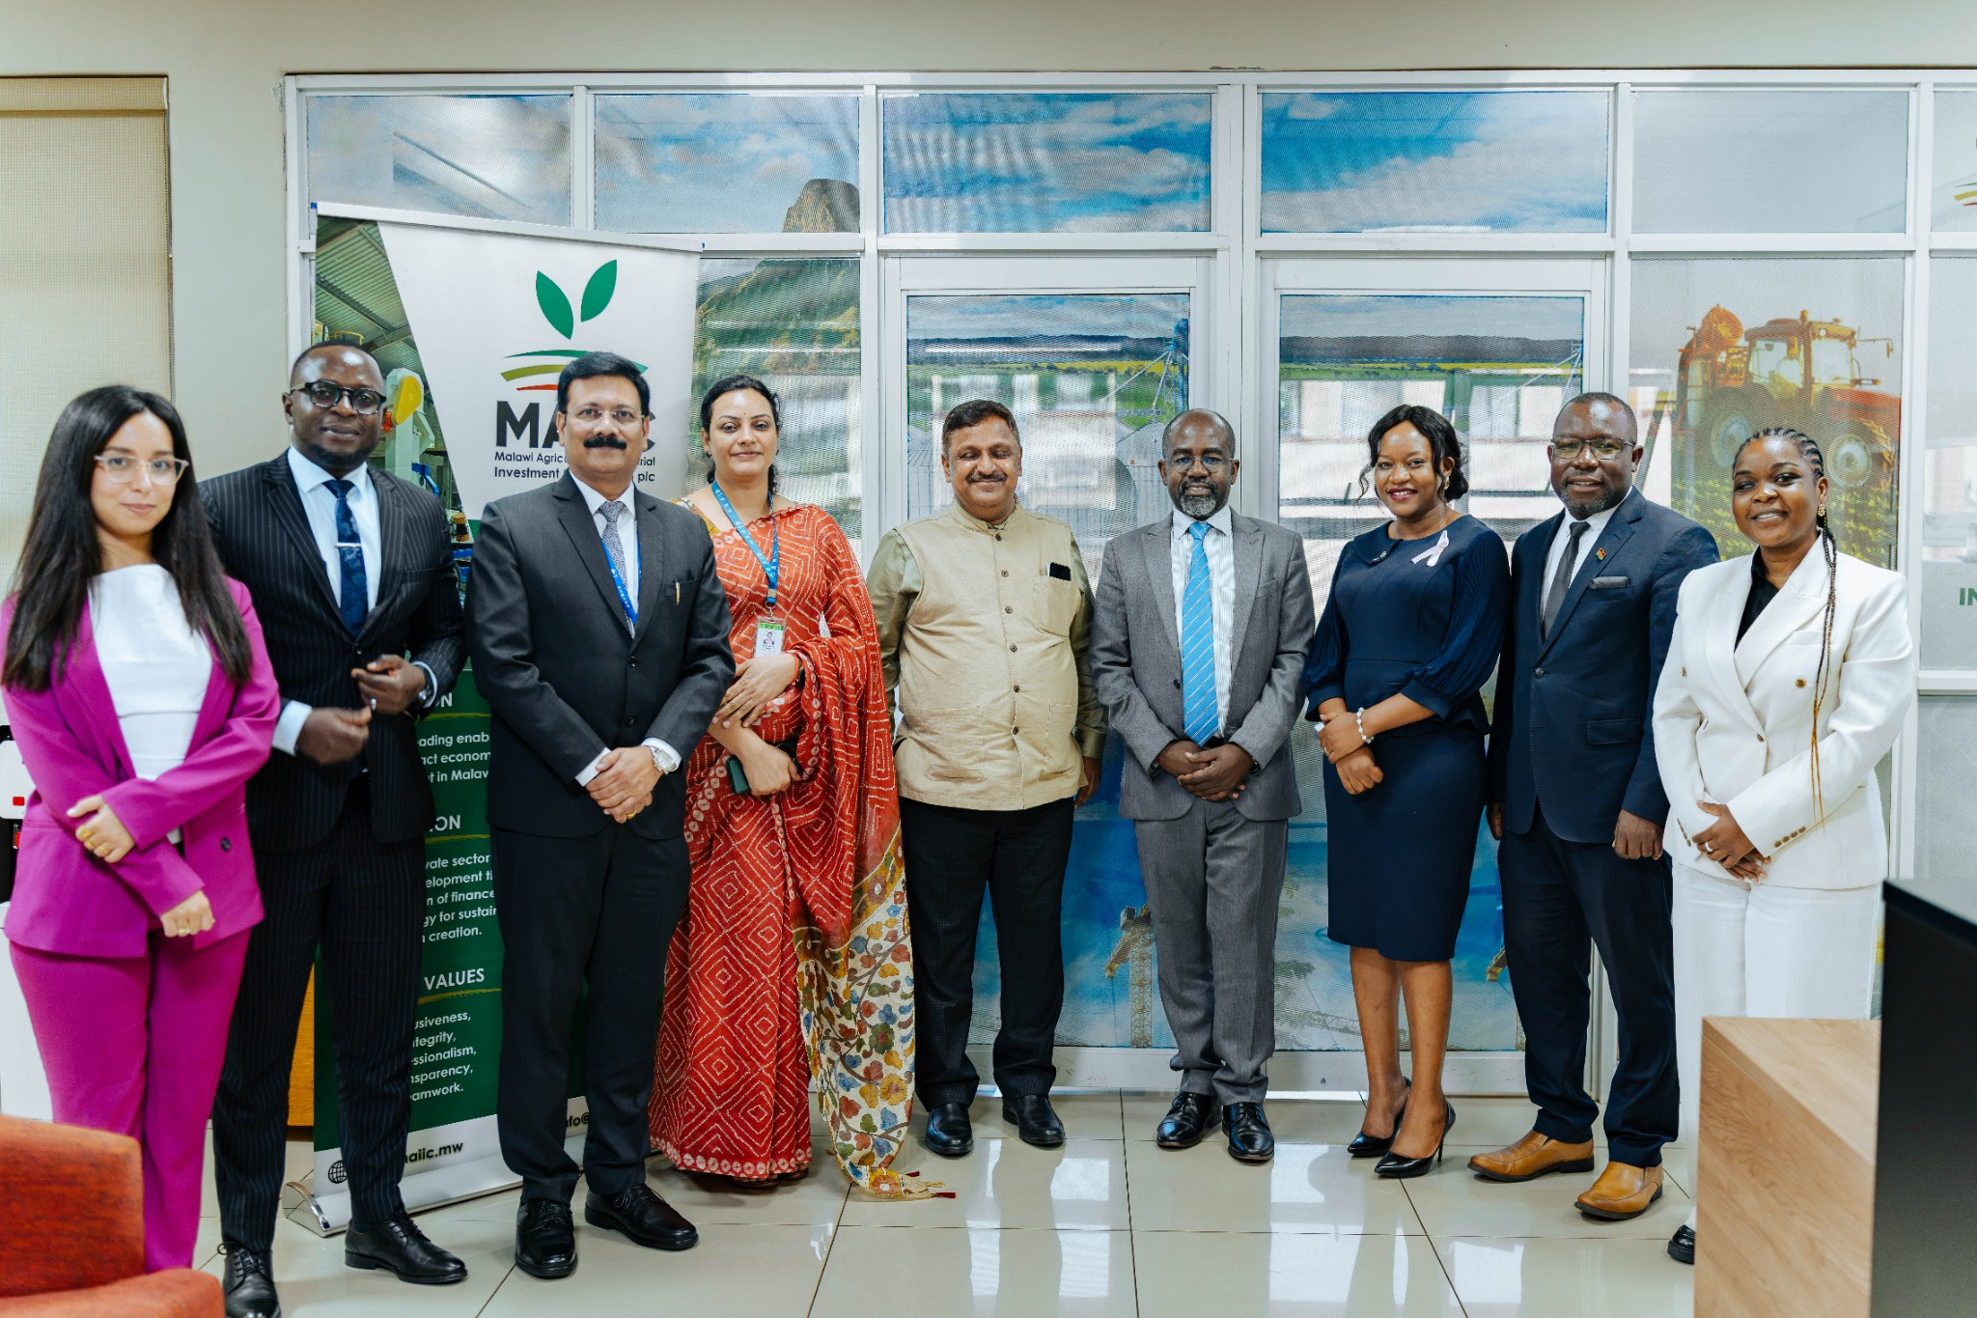
MAIIC / AGRI-PDB PLATFORM
From peer learning
To implementation
MAIIC–NABARD exchange: implications for development finance
Peter Chipeta
Head of Enterprise Development, MAIIC
28 October 2026

Slide 2
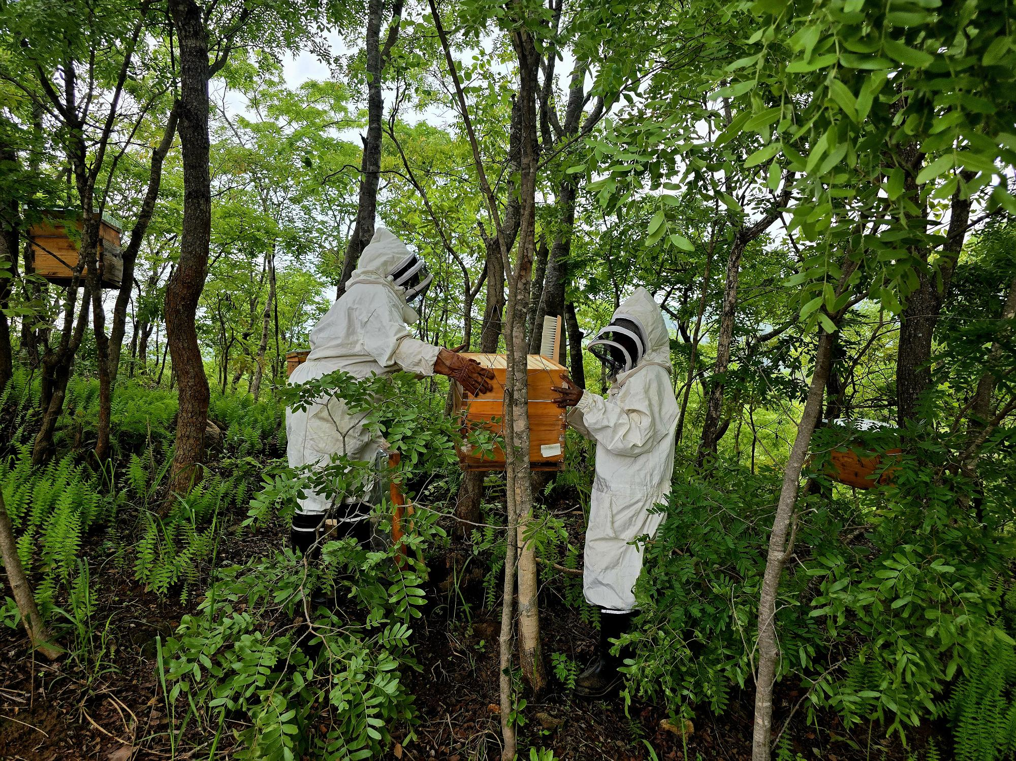

Malawi’s land context and MAIIC’s priorities
118,484 km² total area / 22.2 million people (2025)
Context | Figure and reference period
Economic buffers | US$637 GDP/person; poverty 76.4% (2025)*
Cultivable land estimate | 5.3m ha (FAO, 2003; historical estimate)
Recorded arable land | 4m ha (FAO / World Bank, 2023)
Farmed garden area | 3.54m ha reported (NSO, 2025)
Efforts to improve productivity | Irrigation: 43,370 ha; restoration: 4.5m ha by 2030
Beekeeping supports forest stewardship
Ntcheu, Malawi · ©FAO/Cynthia Mahata
Restoration focus
Soil and water conservation • agroforestry • natural regeneration
Recovery of degraded forests and catchments
MAIIC: finance viable investments that improve land and water productivity.

Slide 3

Yield gaps across selected value chains - maize, rice and soybean
Yield in tonnes per hectare (t/ha)
Value chain | Reported actual yield | Policy target | Technical potential
Maize | 2.1 | 4.0 | 10.0
Rice | ≈2.0 | 4.0 | 6.0
Soybean | ≈1.2 | 2.0 | ≈4.5
MAIIC: assess local production conditions, farmer cash flow and a credible route to market

Slide 4

NABARD exchange: lessons for implementation
Documented exchange focus | Lesson for MAIIC to apply and test
Farmer institutions and local adaptation | Strategy: co-design a focused value-chain pilot with producers
JIVA and natural-farming learning priorities | Farmer support: fund advice and demonstrations alongside credit
Rural finance, risk sharing and evidence | Portfolio: assess transition cash flow and monitor adoption and returns
Adapt to Malawi’s institutions and markets, with named partners and funded delivery

Slide 5

MAIIC can apply the concept through four channels
Concept note priority
Application for MAIIC to develop
01
Adapted financial products
Use direct investment and or PFIs, with terms suited to transition
02
Advisory and technical support
Partner on locally suitable practices and farm economics
03
Training and capacity building
Build staff skills and support farmer demonstrations
04
Partnerships and networks
Agree delivery roles with producers, advisers and buyers
MAIIC’s mandate: viable investment with development impact and financial sustainability

Slide 6
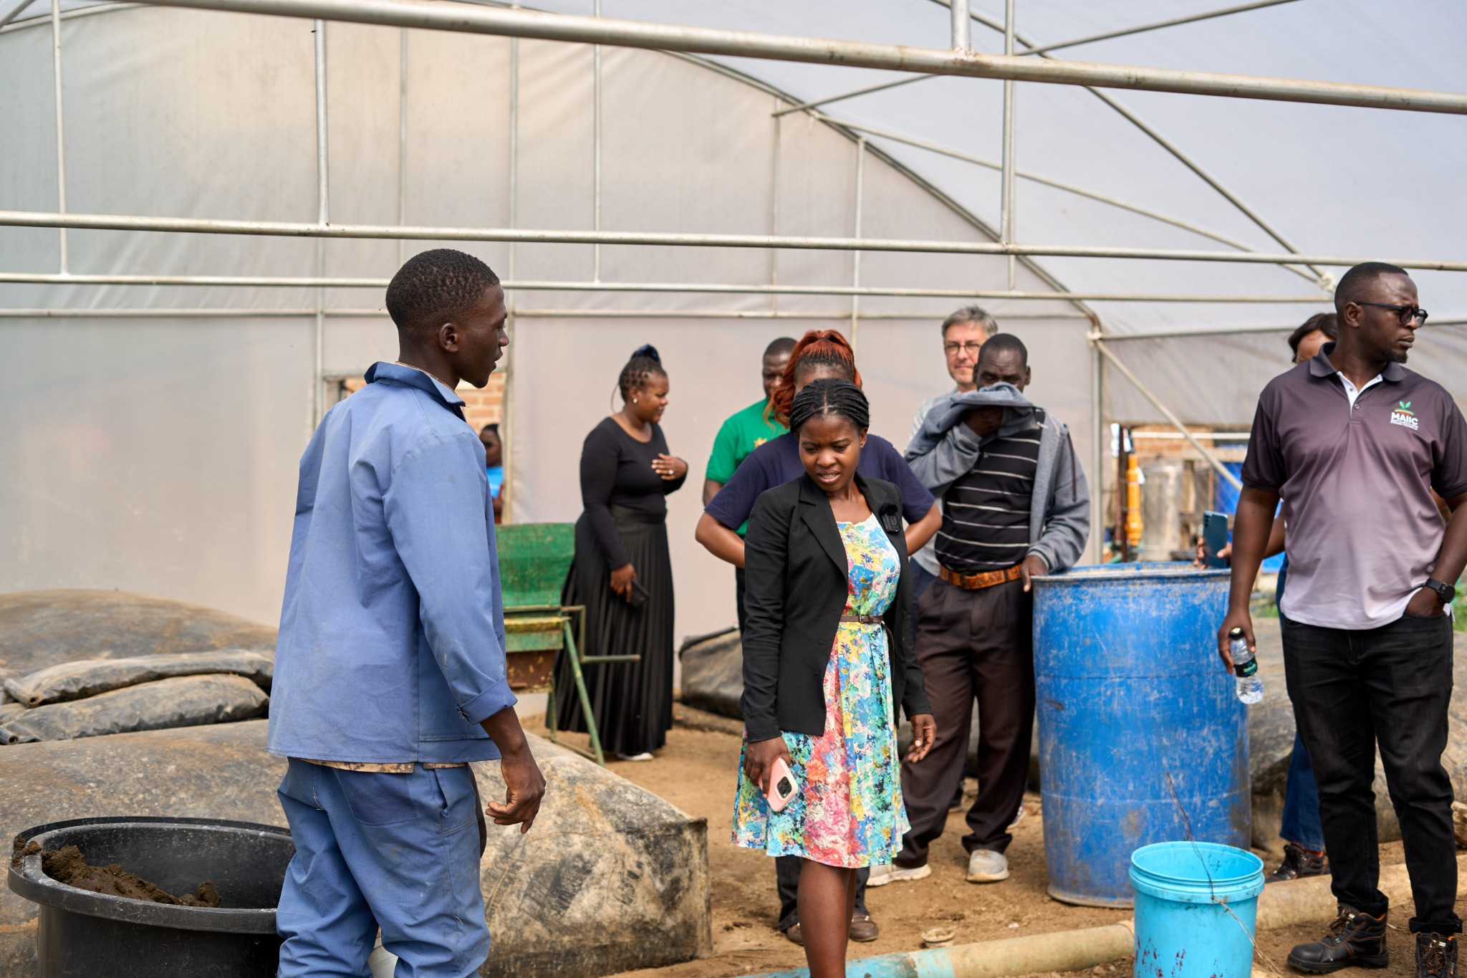
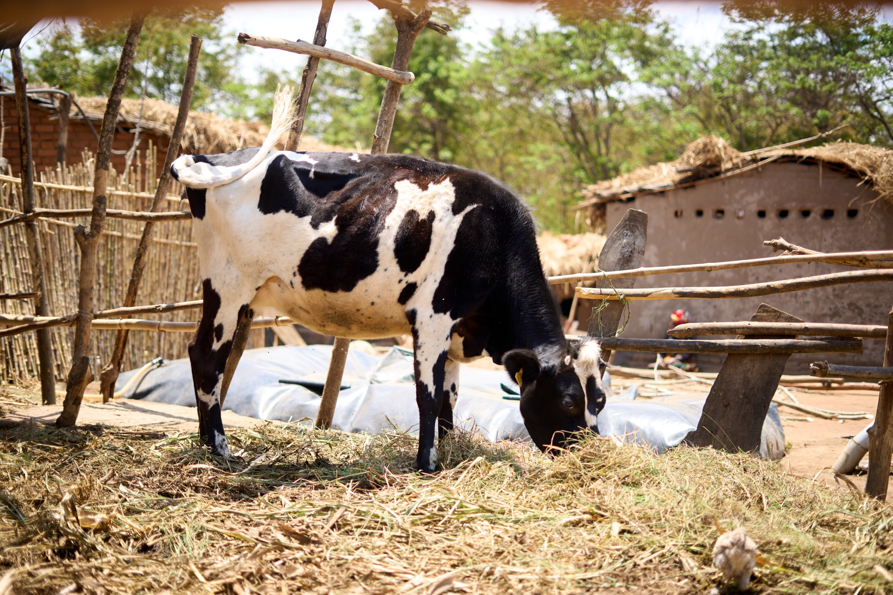
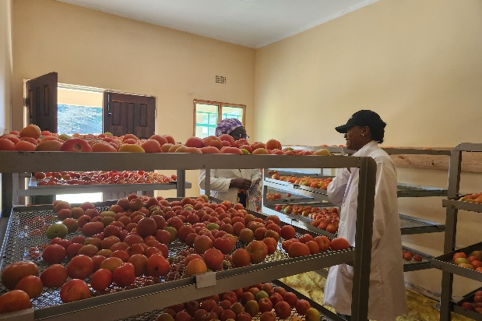

MAIIC enterprises provide entry points for transition
EcoGen
Kwithu Kitchen
Biodigester installed at a
girls’ secondary school
Manure for a biodigester
Woman-owned cow, rural Malawi
2,000+ households / 500+ farmers
1,000+ smallholder linkages / 26+ jobs
Biogas and renewable-energy solutions
Local food processing and smallholder sourcing
Appraisal lens: affordability, installation and servicing
Appraisal lens: supply agreements and payment timing

Slide 7

Financing choices must match transition needs
Financing need | Possible instrument | Design discipline
Seasonal operating costs | Seasonal working capital | Repayment follows sales
Assets with delayed returns | Investment loan | Tenor fits benefit timing
A specific lender risk barrier | Partial guarantee | Define cover and exclusions
Transition support and learning | Technical-assistance grant | Fund delivery and verification
Pair suitable finance with funded advice, farmer participation and a route to market

Slide 8

Next steps: a pilot supported by peer collaboration
01
MAIIC and partners: prepare a focused pilot
Farmer-led design, viable cash flow, eligibility and funded support
02
Platform support: develop shared methods
Appraisal training, practice records and proportionate assessment
03
Peer banks: review evidence before expansion
Compare adoption, net income, repayment, inclusion and delivery costs
A proposed follow-up agenda for technical assistance and continued peer exchange

Slide 9
Thank you
Peer learning that informs financing and farmer support
Spearheading Private Sector Development

