Slide 1

Blue Finance &
Aquatic Food
Systems
WAEMU regional approach for diversifying
aquatic food value chains and cross-border
fisheries governance
Aïssatou DIAGNE
Principal Climate Finance Officer, DFDD — BOAD
October 20, 2026

Slide 2
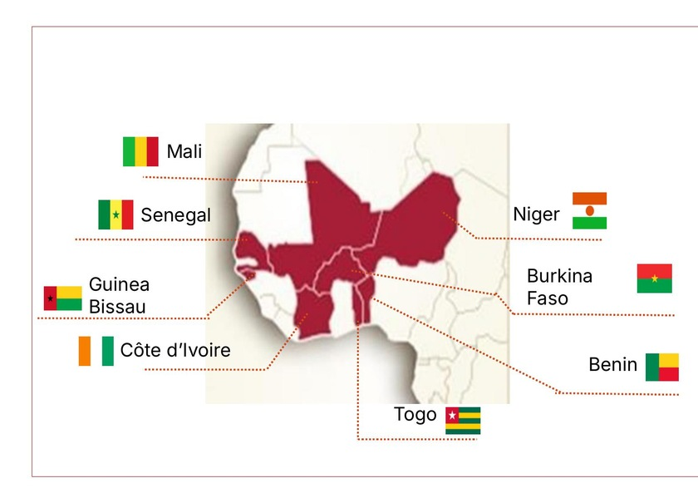
Regional Area of Operation — WAEMU
Map of 8 Member States · HQ: Lomé, Togo · Presence across West Africa
🇨🇮 Côte d'Ivoire
8 Member
States WAEMU
Founded in 1973, BOAD is the common development institution of the member states of the West African Economic and Monetary Union.
1973
Founded
$9.6B
Assets
Baa1
Moody's
8 Member States
127M People
GCF · GEF · AF Accreditation
FEC 0% Climate Studies

Slide 3
Djoliba La Suite Plan — 6 Strategic Pillars
Horizon 2024–2030 · BOAD's climate-centred development framework
I
II
III
Agrifood & Food Security
Resilient Infrastructure
Human Development
Financing the agricultural value chain, aquaculture, and sustainable fisheries. Aquatic food systems integrated as a cross-cutting priority.
Roads, energy, drinking water, irrigation. Climate resilience approach embedded in all infrastructure projects.
Health, education, social protection. High-impact social projects for vulnerable populations in coastal and rural areas.
CIP · FEC · Aquaculture
Adaptation · Water · Energy
Gender · Social · Youth
IV
V
VI
Financial Markets & Private Sector
Governance & Institutions
Regional Integration
Private sector mobilisation, capital markets, green and blue bonds. Blended finance instruments and guarantees.
Institutional capacity building, fiscal systems, public financial management across the 8 WAEMU member states.
Cross-border projects, economic corridors, WAEMU/ECOWAS cooperation. Shared natural resource governance.
Green Bonds · PPP
Institutions · Fiscal
WAEMU · ECOWAS · Regional
🌿 CROSS-CUTTING CLIMATE & ENVIRONMENT
50% Climate finance target by 2030
EUR 750M BOAD Green Bond
FEC 0% Feasibility Studies
GCF · GEF · AF Direct Access

Slide 4
BOAD–WASOP Framework & Regional Roadmap
02
Memorandum of understanding, strategic partnerships and project pipeline 2025–2030
WASOP × BOAD
2025
Launch of regional roadmap
Partnership Framework
West Africa Sustainable Ocean Plan
BOAD–
WASOP:
Regional
Governance
MoU signed with Cape Verde (ECOWAS presidency). BOAD co-chairs the sustainable fisheries finance coordination platform in West Africa — the first such agreement in the region.
Identification of the fisheries and aquaculture project pipeline across 8 WAEMU states, with prioritisation of cross-border investments.
2026
Côte d'Ivoire Climate Investment Programme (CIP)
MoU
Memorandum of Understanding
Cape Verde + EBID signed
Programmatic approach: project pipeline to be financed through BOAD resources and the Climate Studies Fund (FEC at 0%).
A structural partnership to coordinate financing of aquatic food systems across the 8 WAEMU states.
Guinea-Bissau
Debt-for-Nature Swap
2030
Target: EUR 150M/year in blue finance
Debt conversion mechanism for nature investment — protection of marine areas and financing of sustainable fisheries resource management.
Deployment of the regional blue credit line and mobilisation of GCF, GEF, and Adaptation Fund windows.
372 M$
Blue CIV — Côte d'Ivoire CIP
Sustainable Fisheries · Aquaculture · Coastal Management

Slide 5
Diversifying Aquatic Food Value Chains
03
Fisheries · Aquaculture · Seaweed Farming — at WAEMU regional scale
🎣
🐠
🌿
Sustainable Fisheries
& Fisheries Governance
Aquaculture — Inland
& Lagoon Production
Seaweed Farming —
Livelihoods & Women
West Africa hosts one of the world's most productive fishing zones, yet faces mounting pressure. Through the WASOP framework and Djoliba La Suite plan, BOAD co-finances cross-border fisheries resource governance.
Areas covered: Atlantic coast (Senegal, Guinea-Bissau, Côte d'Ivoire), Niger River (Mali, Niger, Benin), Volta (Burkina Faso, Togo).
High-potential sector across sub-Saharan Africa. BOAD supports pilot projects in Côte d'Ivoire (Ébrié Lagoon) and Togo.
Integrated in the Côte d'Ivoire Climate Investment Programme (CIP) — feasibility studies financed through the Climate Studies Fund (FEC at 0%).
Emerging value chain with strong social impact: seaweed cultivation in coastal zones, led primarily by women. Multiple benefits — food, cosmetics, natural fertilisers, carbon sequestration.
BOAD is exploring seaweed farming integration into its blue credit lines as a lever for economic empowerment.
WASOP
Regional platform
co-led with BOAD
FEC
0% feasibility
study financing
♀
Gender priority &
coastal communities
Artisanal Fisheries · Governance · WAEMU Zones
Côte d'Ivoire · Togo · BOAD CIP
Seaweed · Women · Social Impact
Djoliba La Suite · Agrifood · Fisheries Governance · Aquaculture · Seaweed Farming

Slide 6
BOAD Financing Instruments — Blue Finance
Blue credit lines · Climate Studies Fund (FEC) · Blended finance · Green bonds
💳
2 Blue Credit Lines — Aquatic Economy
🔬
Climate Studies Fund (FEC) — 0%
BOAD has structured two dedicated blue credit lines: one targeting fisheries and aquaculture operators, the other focused on sustainable coastal infrastructure.
Flagship instrument of the Djoliba La Suite plan: zero-interest financing for feasibility studies on climate projects identified under the Climate Investment Programme (CIP).
2
€150M/yr
Blue Bond
0%
CIP CI
Pipeline
Dedicated lines
2030 Target
Under dev.
Interest Rate
CIV Programme
Projects ID'd
🌐
Blended Finance — GCF · GEF · Adaptation Fund
📈
Capital Markets — Green & Blue Bonds
Direct access to the three main multilateral climate windows. BOAD uses these concessional resources to improve project financial conditions and attract private co-investors.
Moody's Baa1 rating and USD 9.6B balance sheet give BOAD access to international markets. The EUR 750M green bond demonstrates strong capital-raising capacity.
GCF
GEF
AF
Baa1
$9.6B
€750M
Green Climate
Global Env.
Adapt. Fund
Moody's
Assets
Green Bond
2030
€150M/yr
$250M
30 projects
5,000
Target Year
Annual Blue Finance
Aquatic Pipeline
By 2030
Jobs Targeted

Slide 7
"In West Africa, fish don't respect borders
— and neither should finance."
3 ASKS TO THE FiCS PLATFORM
1
Adapted Blue Taxonomies
Support the development of taxonomic frameworks for aquatic food systems in sub-Saharan Africa.
2
Guarantees & De-risking
Mobilise risk-sharing mechanisms (partial guarantees, co-investments) to catalyse private finance.
3
Peer Exchange
Structure a network of development banks sharing best practices in regional blue finance.
$250M
30
5,000
Aquatic pipeline
ambition
Targeted projects
by 2030
Direct jobs
to create

Slide 8
?
Open Discussion
Questions & Answers
We invite you to ask questions about BOAD's blue finance strategy,
the Climate Investment Programme (CIP), the Climate Studies Fund (FEC),
and our regional partnerships for the blue economy in West Africa.
Aïssatou DIAGNE
BOAD
Climate Finance Officer, DFDD — BOAD
WEST AFRICAN
DEVELOPMENT BANK
www.boad.org
FiCS Ocean Coalition · October 20, 2026

