Slide 1
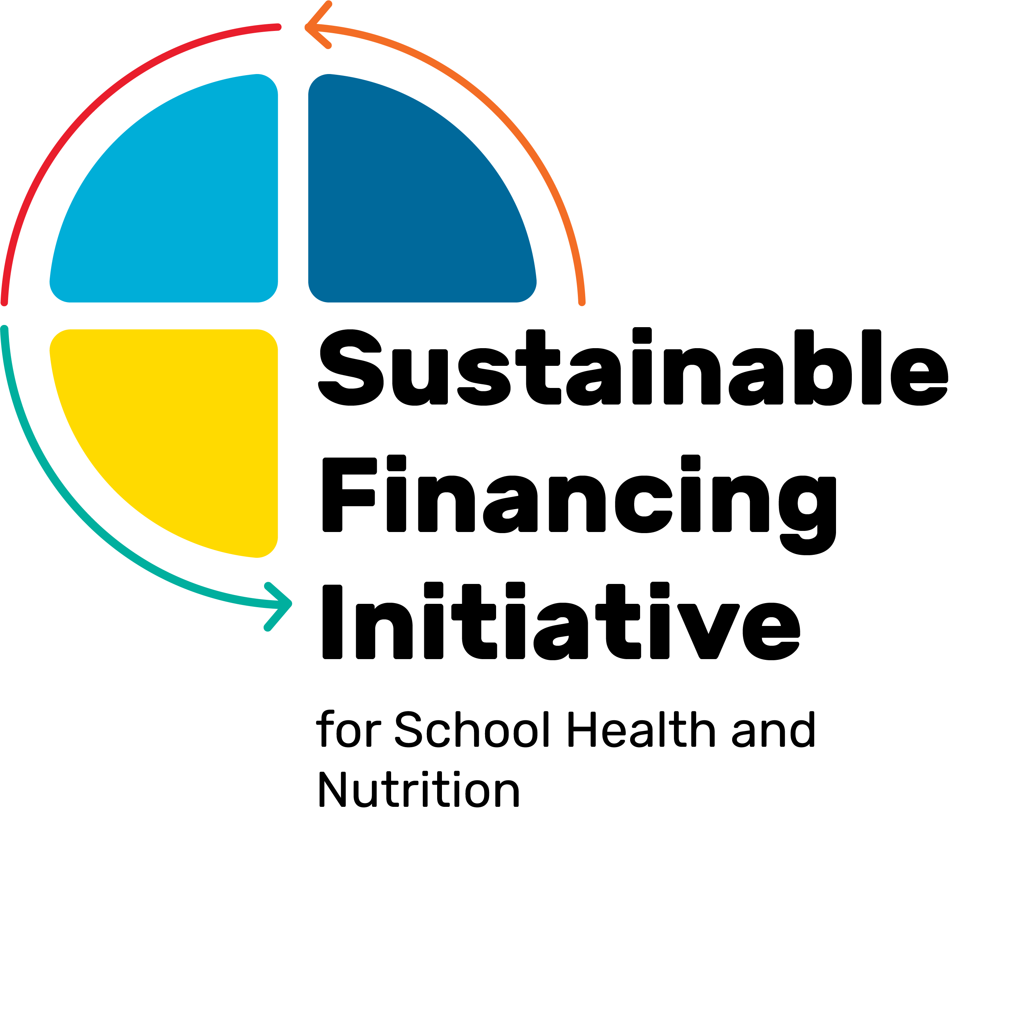













School meals as a food systems investment
SFI × AGRI-PDB PLATFORM WEBINAR / 22 OCTOBER 2026
The Role of Agri-PDBs
Thursday 22 October 2026 - 2:00 – 3:30 PM CEST

Slide 2
School meals demand and PDB Finance
School meals create recurring demand. PDBs have significant agricultural finance.
SCHOOL MEALS DEMAND
PUBLIC DEVELOPMENT BANKS
466m
$84bn
57%
≈⅔
of formal agricultural finance
children reached globally
annual spending on school meals
of programmes aim to benefit smallholders
≈$1.4tn
Annual investment
The opportunity: Leverage school meals demand to unlock investment in local food value chains, while shaping more nutritious, inclusive and climate-resilient food systems.
Sources: WFP (2025); GCNF (2024); Agri-PDB Platform (2024 annual report).
2

Slide 3
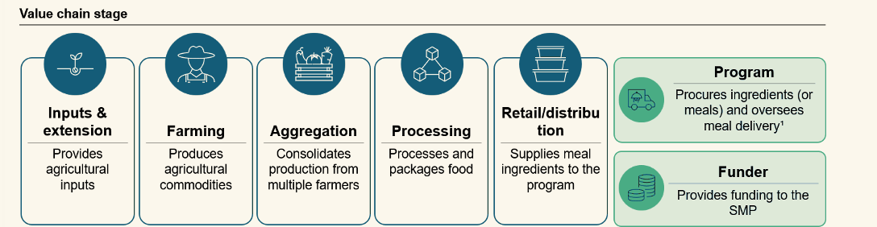
School meals demand reaches across the food value chain
Agri-PDBs can finance value chain actors at different nodes
School meals procurement can create structured demand – farmers, cooperatives, and agribusinesses need the capacity and financing to respond.
3

Slide 4
Homegrown school feeding requires both demand and supply
Well-designed procurement can open reliable markets for smallholder farmers and local agribusinesses
WHAT
HOW MUCH
PRICE
DELIVERY
PAYMENT
menu (commodities) and quality
Quantities and contract sizes
Fair prices for buyers and suppliers
when, where, how
Predictable and timely payments
DEMAND-SIDE POLICY
SUPPLY-SIDE SUPPORT
Credible public purchasing commitments
Predictable demand, appropriate procurement terms, and timely payments
Building actors’ capacities across the school meals value chain
Training, inputs, technology, infrastructure and appropriate financing
4

Slide 5
From school meals demand to investment-ready value chains
Agri-PDBs and partners can help bridge the gap by strengthening value chain actors’ capacities and investment readiness
1 DEMAND FOR FOOD
Demand is structured through procurement systems and procedures
Governments set menus, volumes, prices, supplier rules, delivery conditions and payment terms.
↓
2 THE BRIDGE – CAPACITY STRENGTHENING AND INVESTMENT PREPARATION
Non-repayable finance in the form of grants + targeted TA
Strengthen the technical and financial capacities of those in the value chain to be able to access credit in the future
↓
3 DEMAND FOR FINANCE
Agri-PDBs and partners can help develop a pipeline of viable investments
Prospective borrowers can seek working-capital and asset loans where cash flows support repayment.
5

Slide 6
Three financing opportunities across the SMP value chain
The appropriate financing instrument depends on the value chain actor
1
2
3
ASSET FINANCE
SEASONAL CREDIT
WORKING CAPITAL
Farmers and producer groups
Cooperatives and aggregators
Processors and logistics firms
Inputs and crop-cycle production costs
Buy harvests and bridge payment lags
Storage, processing and kitchen equipment
Repayment from crop sales
Repayment from verified buyer receipts
Longer-term cash flow from operations
6

Slide 7



Ghana: one bank financing both ends of the chain
In 2021, ADB linked farmer credit with working capital for an agricultural buyer serving public institutions.
AGRICULTURAL DEVELOPMENT BANK (GHANA)
Value-chain finance linking producers and buyers
Repayment
Repayment
Payment
Payment
FARMERS
NAFCO
SENIOR HIGH SCHOOLS
ADB-financed farmers and participants
in Planting for Food and Jobs (PFJ)
National Food Buffer Stock Company
Purchases produce from farmers
Commodities
Public institutional food supply
(and other institutions)
Commodities
PFJ: flagship government agricultural initiative
Also maintains food buffer stocks
The purpose: connect ADB-financed farmers and PFJ participants to an institutional food market
7
Source: Authors elaboration based on ADB Ghana, 2021 Annual Report, p. 30

Slide 8
Agri-PDBs can develop markets — not just finance transactions
School meals are typically funded through education and social protection budgets, while the associated investment opportunities lie within agricultural value chains.
1 RECOGNISE OPPORTUNITIES
2 COORDINATE ACROSS SECTORS
3 DEMONSTRATE AND SCALE
Connect procurement to agricultural finance
Align procurement and value chain support and finance
Finance viable investments and bring others in
Identifying financing opportunities arising from school meals demand and link them to agricultural investment portfolios
Work with governments and partners to coordinate procurement, technical assistance, grants and financing
Act as early adopters, demonstrate viable financing models and crowd in other financiers over time
The development role: not simply to finance the agricultural supply response, but to help shape which markets develop, who participates, and what nutritional, social and environmental outcomes they deliver.
8

