Slide 1


Advancing Quality Jobs Through Agricultural Public Development Finance:
ADB Sovereign Operations and Technical Assistance.
18 August 2026
Carlos A. Coca Gamito, Labor Market Specialist (ADB Consultant)

Slide 2
Establishing an enabling policy and institutional framework: Bhutan
TA-10070 REG: Youth Employment Studies
Support the development of the National Entrepreneurship Strategy
Agricultural entrepreneurs faced greater difficulties accessing public entrepreneurship support
Key ecosystem constraints identified at macro, firm and individual levels
PDB contribution: Use access to finance and preferential lending to incentivize quality employment creation, rather than targeting support solely by sector
2

Slide 3
Policy dialogue and programme design: Uzbekistan
TA-54100 REG: Quality Jobs and the Future of Work
Extension of social insurance to informal workers, including agricultural workers
Research and outreach: understanding workers' needs, awareness and trust as determinants of enrolment
Programme design: actuarial analysis of maternity and sickness benefits and coverage options for informal workers (e.g. household plot farmers).
Policy exchange: regional unemployment insurance conference and NASP study visit to Malaysia
PDB contribution: Act as facilitators and knowledge brokers for policy dialogue, programme design and international learning
3

Slide 4
Adopting international standards and best practices: Azerbaijan
TA-54100 REG: Quality Jobs and the Future of Work
Gap assessment of the national OSH system
Benchmark institutions and policy instruments against international standards and good practices
Identify institutional and policy gaps and recommendations for reform
PDB contribution: Translate international standards into institutions, policies and implementation mechanisms, including for agricultural workers
4

Slide 5
Conclusion: How PDB sovereign operations can support quality agricultural jobs
Three complementary channels:
Enabling environment → Support linkages between private sector development and quality employment
Policy & programme design → Extend social protection to workers
Institutions & standards → Strengthen labour standards and institutional safeguards
Quality job creation in agriculture requires more than financing investment: employment creation needs to be connected with social protection, labour standards and institutional safeguards.
5

Slide 6
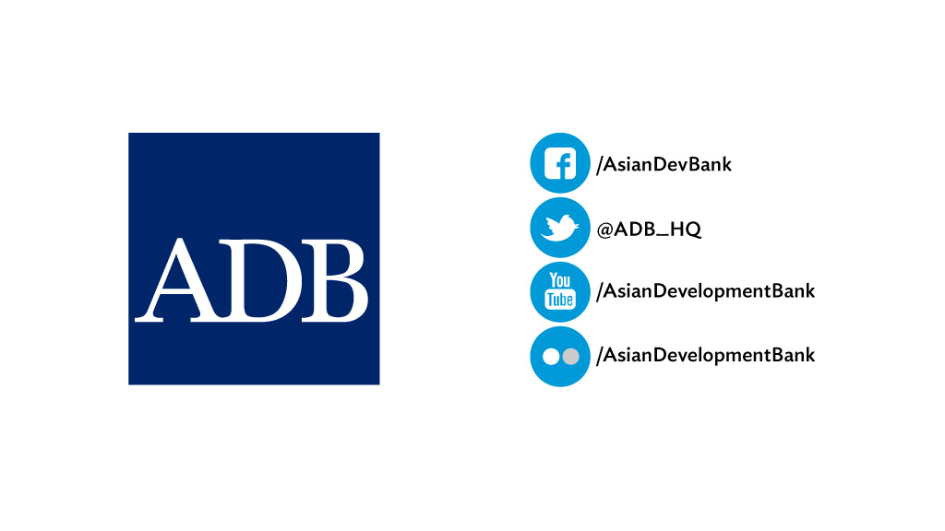
www.adb.org

