Slide 1
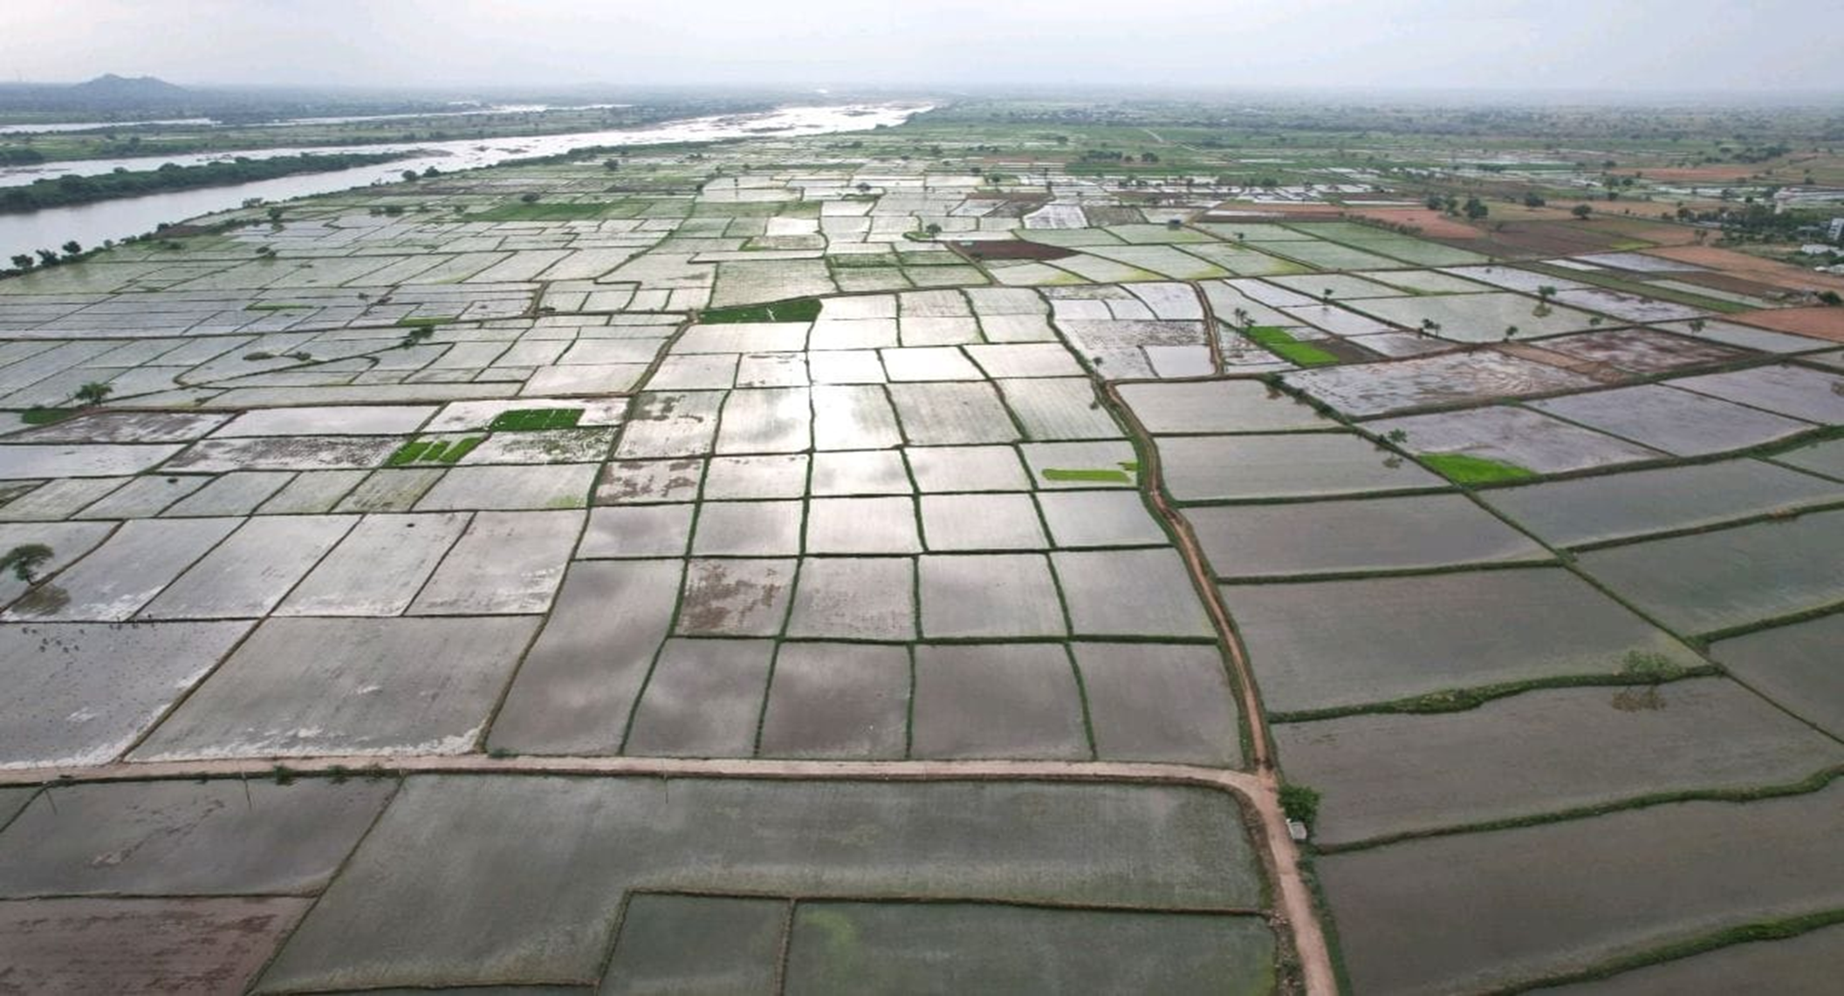
RICE METHANE EMISSION REDUCTION
Carbon Credit Project
Reducing CH4 emissions in paddy cultivation through Alternate Wetting and Drying (AWD)
Kosher Climate India Private Limited

Slide 2

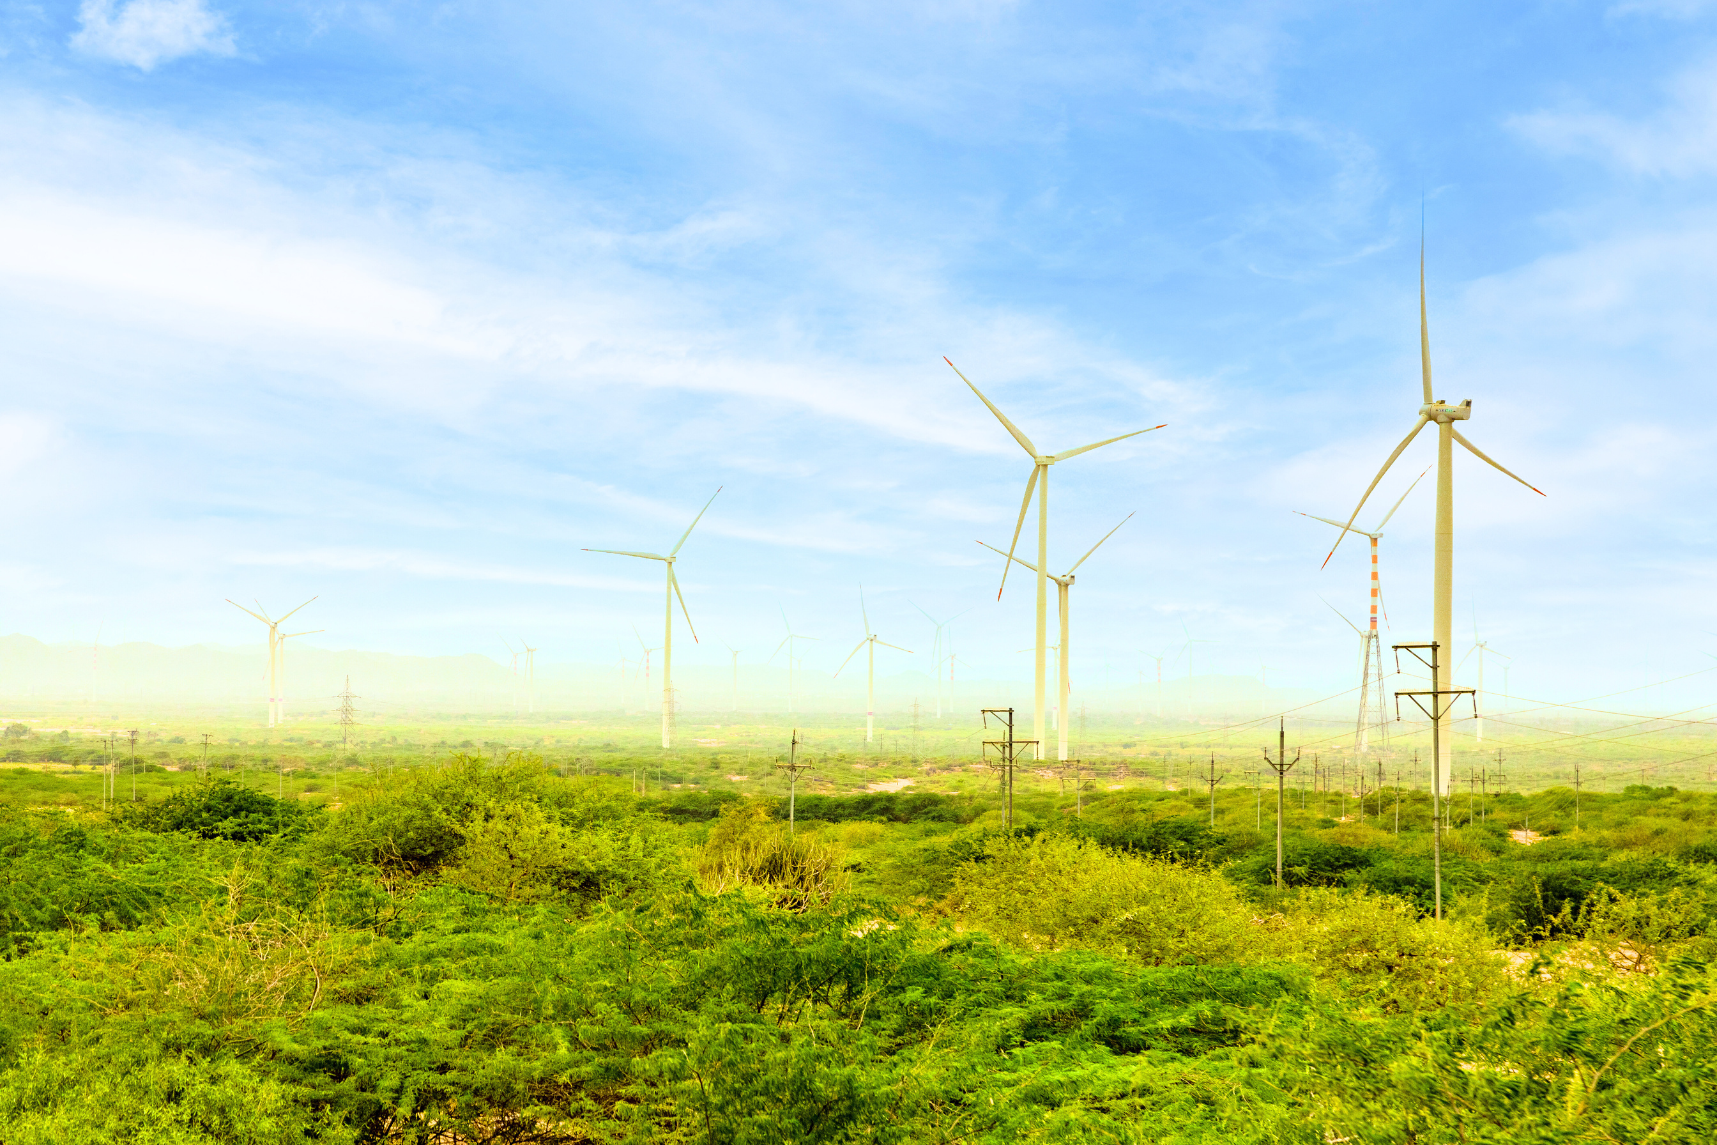






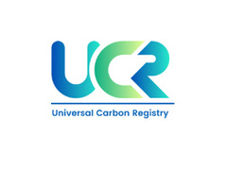
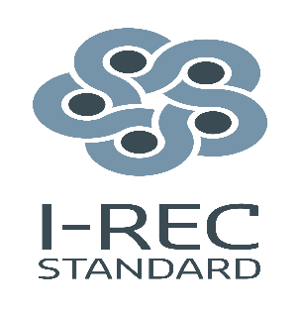


OUR IMPACT
Who We Are
We are a frontrunner in the carbon markets with an impeccable track record and a wide buyer network.
We are a dynamic team with expertise across sectors, dedicated to driving sustainability and carbon neutrality. With over a decade of experience in the carbon market, our mission is to provide tailored carbon credits and offsetting solutions for businesses and project developers worldwide to achieve their Net-Zero aspirations.
We provide carbon advisory for renewable energy projects, implement Nature-based solutions, fostering community development. Our technical advisory services cover ESDD and ESIA, ensuring that every project meets the highest standards of sustainability. We also provide ESG (Environmental, Social, and Governance) reporting services. Our ESG services help clients identify and manage risks and opportunities in these areas, ensuring that their businesses are not only sustainable but also socially responsible. We believe sustainability is not just a goal, it is our responsibility.
300+
Projects
10
Countries
18M+
Carbon credits Issued
REGISTRIES WE WORK WITH
15+ GW
RE Managed
1

Slide 3
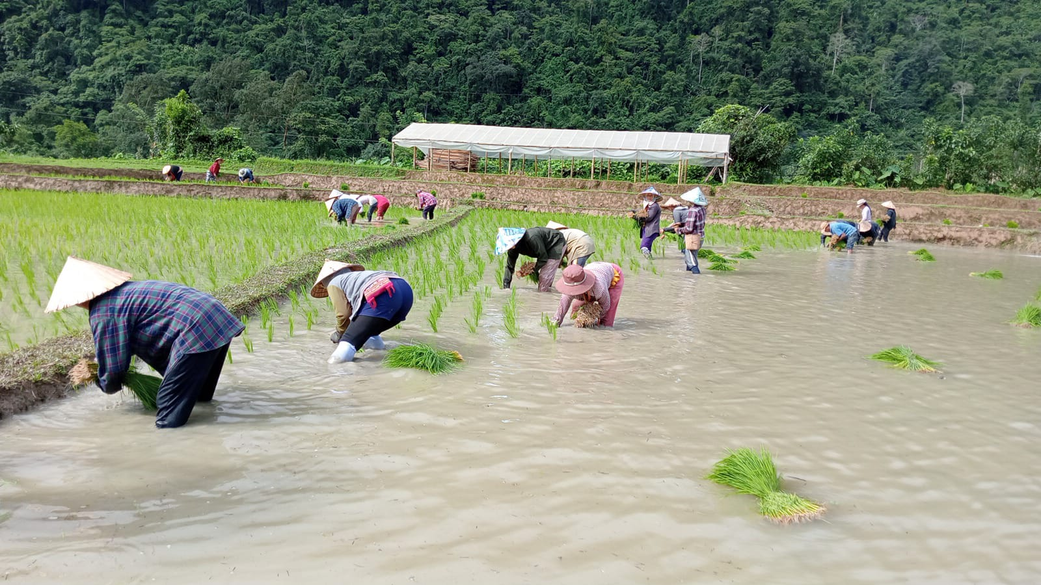


What is Alternate Wetting and Drying (AWD)?
This project reduces methane (CH4) emissions through improved water management practices involving alternate wetting and drying of paddy fields.
AWD reduces CH4 emissions by up to 48% compared to continuously flooded fields, where high CH4 rates result from anaerobic decomposition of organic matter.
The AWD water tube
A 30 cm perforated plastic or bamboo pipe installed vertically in the paddy field to monitor water levels.
About half the tube sits below the soil surface; the rest protrudes above ground for easy observation.
Placed near a field bund at a representative location, with perforations allowing free water movement for accurate level readings.
Farmers use the tube to decide when irrigation should be withheld and resumed under AWD practice.
Lao PDR AWD
SDG impacts
Increased land productivity, raising farmer incomes over the project lifetime
Local employment generated through project activities
Direct and measurable improvement in farmer income

Slide 4









Project Implementation: Ground Zero Activities
From site selection through field-level pipe installation
1. Project area selection
2. Baselining & feasibility study
3. Identify ground partner
Identify double-cropping paddy areas with no change in cropping system in the last 10 years, non-rainfed land with irrigation facilities, and farmer land ownership.
Field survey documenting baseline land, water and nutrient management practices, harvesting cycles, and yield data for each farmer and plot.
Select NGOs, CBOs, or Farmer Producer Companies with strong local presence, field experience, and a network of staff in interior villages.
4. Training & capacity building
5. Farmer awareness training
6. Stakeholder consultation
Residential training for field staff covering climate context, digital data entry, field mapping, pipe installation, drying-event monitoring, and farmer engagement.
Village-level meetings to build trust and awareness of AWD among farmers and local stakeholders.
Pre-listing consultations with government, NGOs, and village governing councils; formal land-tenure agreements and Free, Prior & Informed Consent (FPIC).
7. Onboarding of farmers
8. Training of onboarded farmers
9. Procurement & pipe installation
Sign contracts, register farmers via mobile app with ID and land documents, and capture crop and land details for validation.
Continuous seasonal training to ensure correct implementation of AWD interventions and maximize farmer benefits.
Transport perforated pipes, provide them to each farmer, and install with GPS-mapped locations within designated polygon areas.

Slide 5
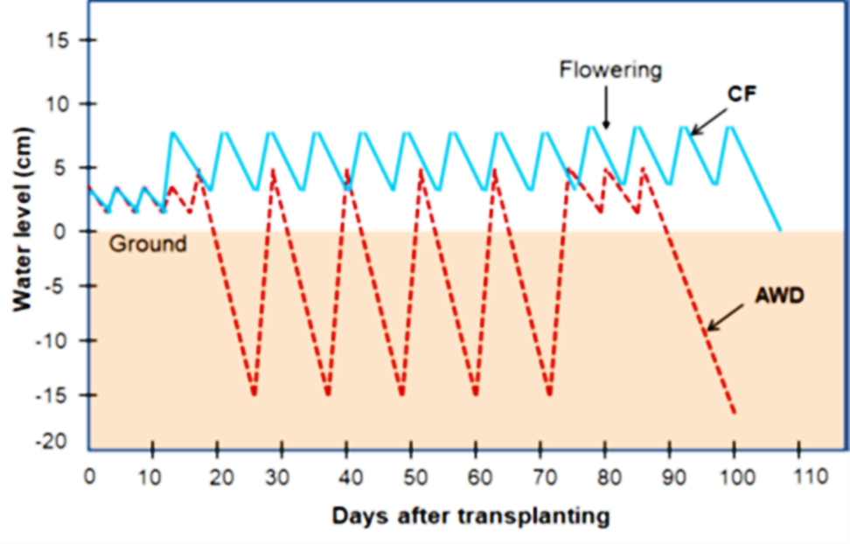

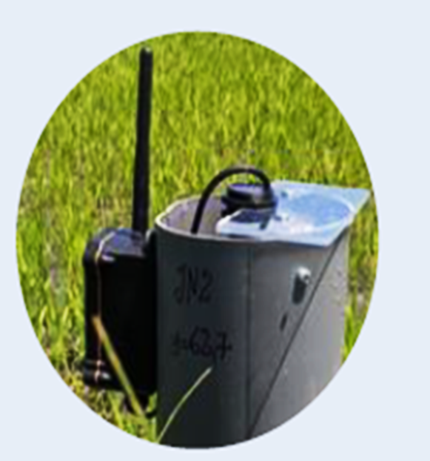
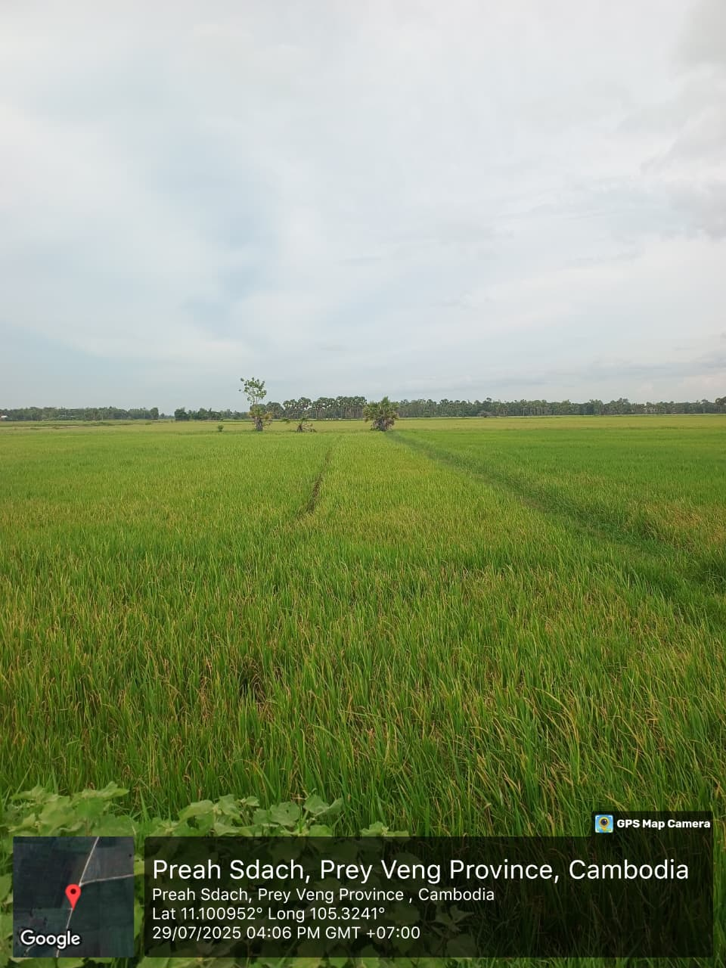
Three-Tier Verification Model
After pipe installation and paddy transplantation, the field team begins continuous manual and digital data collection and monitoring across all plots. To strengthen this ground-level process, a parallel digital verification layer—powered by satellite monitoring and IoT sensors—runs alongside it, closing the transparency gap that manual-only monitoring tends to leave open.
Satellite imagery (SAR + optical)
Field boundaries, rice mapping, cropping cycles, and drainage events — cloud-independent.
Ground-truth data
Each farmer put his/her entry in logbooks of aeration events. Parallelly the ground team collect the data related to boundary mapping, farmers details, land records etc. through our own mobile application with geofencing authentication feature.
AWD vs. continuous flooding (CF): paddy water-level cycle
IoT water-depth sensors
Devices Installed in some places of project area as a sample set; real-time water level data is collected through sensors. Based on Sensor data we refine the error in satellite-based model.
Triangulated for accuracy & transparency: satellite, IoT, and ground data are cross-verified against each other.
Cambodia AWD

Slide 6
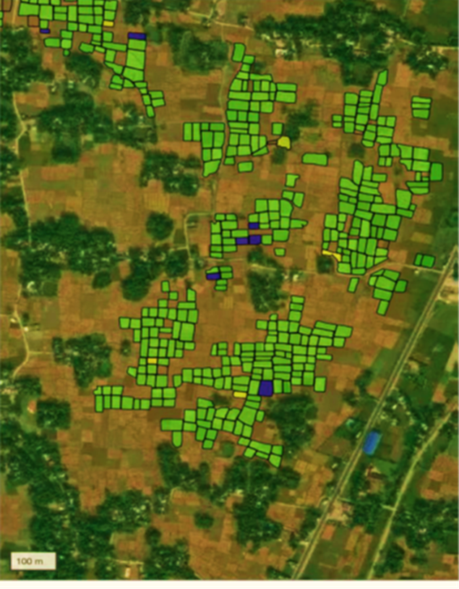

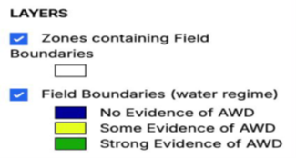


Digital MRV: Satellite-Based Monitoring
A parallel digital verification layer addressing the transparency gap in manual, ground-only monitoring. This is managed by Paris – based farm Carbonfarm
Automated field segmentation
Rice presence & cropping cycles
AI-based delineation of all paddies from high-resolution satellite imagery, cross-verified with manually captured field polygons.
12-month assessment of rice cultivation per field; excludes non-rice fields and detects growing cycles via pre-season water regime.
All-weather SAR + optical monitoring
Flood vs. dry classification
SAR provides consistent observations regardless of cloud cover; optical imagery adds field coverage and season-duration detail.
Time-series SAR analysis identifies flooded vs. dry paddies and records average drainage event duration.
Field-validated ML models
Digitized, auditable records
Models validated across diverse geographies and calibrated using ground-based IoT devices for reliable detection.
Logbooks, aeration events, land characteristics, polygon maps, and farmer data digitized for validation submission.
AWD-evidence mapping (satellite) – West Bengal India AWD

Slide 7

Challenges We Faced — Farmer & Social Dimensions
Slide 1 of 2 · Field-tested mitigation measures across India, Laos, and Cambodia
Challenge
Mitigation measure & impact
Farmer fear of yield loss / hesitancy to adopt AWD
Identified lead/early-adopter farmers per village to pilot AWD first, using their actual local yield data for peer demonstration. This scaled the project to over 50,000 ha in India, 500 ha in Lao PDR, and 700 ha in Cambodia.
Farmer drop-out / attrition during project
After the first year, farmers were reluctant to continue due to AWD's discipline requirements. We resolved this by onboarding farmers with financial assistance and signed revenue-sharing agreements to align their incentives with the project.
Social pressure / peer perception of AWD adopters
Social pressure, misconceptions, and rumors discourage participation. Continuous informal engagement through regular community interactions and tea-time meetings helps address concerns, build trust, and counter misinformation.
Drying level cannot always be determined / narrow drying window
Because root depth is shallow in early growth stages, drying must begin only 15–20 days after transplanting and stop 7–10 days before flowering to avoid yield loss. Farmers are trained on this precise window to overcome their yield concerns and simplify monitoring.

Slide 8


Challenges We Faced — Data & Technical Dimensions
Slide 2 of 2 · Field-tested mitigation measures across India, Laos, and Cambodia
Challenge
Mitigation measure & impact
Ground data accuracy & unreliable record-keeping by NGOs/FBOs/FPCs
We established our own on-ground data validation team with a proprietary mobile app featuring geofencing authentication, ensuring it operates only within designated project boundaries to prevent manipulation or false entries.
NGOs lack AWD experience; high failure rate in data delivery
As an early AWD implementer across multiple regions, we partnered with NGOs with no AWD project implementation experience. Despite extensive training on AWD principles, cycles, and challenges, data delivery accuracy remained poor — requiring multiple NGO replacements at additional revenue loss due to upfront payment structures.
Drying events data accuracy & collection challenges
We implemented satellite-based monitoring across all project areas, supplemented by IoT sensors in selected sample plots to validate satellite observations. Sensor data calibrates and refines the satellite models, ensuring high accuracy of event-level monitoring.
Challenge of direct emission measurement
Direct gas sampling proved logistically and financially difficult due to limited nearby laboratories, long transport distances, and sample-integrity constraints. After a costly initial attempt, we now rely on IPCC default emission values. Once the project's funding gap is recovered, we plan to establish in-house testing facilities for direct measurement.

Slide 9
Lessons from Project Development
What works (and what doesn't) across renewables, forestry & community-based carbon projects
Lesson
What it means in practice
Pilot first, scale later
Starting with pilot projects allows developers to validate technical assumptions, identify operational challenges, and build confidence among stakeholders before committing to large-scale investments.
▶
Strong local partnerships
Projects are most successful when governments, local institutions, communities, and implementation partners are actively engaged from the planning stage. Local ownership significantly improves long-term adoption.
⌂
Invest in robust data & MRV
Accurate baseline studies, GIS mapping, and digital monitoring systems reduce implementation risks and simplify validation and verification processes throughout the project lifecycle.
.
⚙
Design for local conditions
Project design should reflect local realities such as land ownership, irrigation infrastructure, farming practices, and regulatory frameworks rather than adopting a one-size-fits-all approach.
.
✎
Common challenges
Many projects face delays due to weak documentation, unclear land tenure, inadequate stakeholder consultation, and underestimating the effort required for long-term monitoring and reporting.
⚠

Slide 10
Credit Integrity
Importance of accredited standards and transparent MRV systems
Principle
Why it matters
Adopt International Standards
Developing projects under recognized standards such as Gold Standard, Verra (VCS), Article 6.4, etc provides internationally accepted methodologies and enhances market credibility. Without these accreditations, credits carry no market weight.
★
Robust MRV systems
A transparent Measurement, Reporting and Verification (MRV) framework ensures that emission reductions are accurately measured, independently verified, and consistently reported. They ensure emission reductions are real, not just claimed.
⚙
Leverage digital technologies
Satellite imagery, GIS mapping, remote sensing, mobile applications, and digital databases improve monitoring efficiency while reducing manual errors and operational costs.
▤
Independent verification
Third-party validation and verification strengthen buyer confidence, improve project transparency, and maintain environmental integrity throughout the crediting period. Publicly available monitoring data and audit trails command price premiums and enhance the project credibility.
.
✓
High integrity = market value
$
Accredited, well-documented credits attract premium buyers and investors; weak MRV risks reputational damage, and as EU, UK, and US markets tighten disclosure requirements, only high-integrity projects trade at full value.

Slide 11
De-risking Tools for Public Development Banks (PDBs)
Long-term offtake agreements, blended finance structures, and pilot project design
Tool / Mechanism
How it helps
Support early-stage development
⚑
Funding feasibility studies, baseline assessments, and project design reduces uncertainty and helps identify technically and financially viable opportunities.
.
Finance Pilot Demonstrations
Pilot projects provide proof of concept, generate field data, and reduce implementation risks before scaling to regional or national levels.
⚖
Blended Finance Structures
Combining grants, concessional loans, commercial finance, and private investment help bridge financing gaps while improving overall project bankability.
$
Long-Term Offtake Agreements
Forward purchase agreements for carbon credits provide predictable revenue streams, improving investor confidence and facilitating project financing.
⇄
Invest in Local Capacity
Supporting technical training, digital MRV systems, and institutional capacity strengthens project implementation and reduces long-term operational risks.
⌂

Slide 12
Revenue Sharing Models
Ensuring traceability and fair distribution to communities and landowners
Practice
Impact on communities
Transparent benefit-sharing
⚖
Clearly defined revenue-sharing mechanisms build trust among communities, governments, and project developers while improving long-term participation.
.
Provide Early Adoption Incentives
Offering small advance payments or seed funding to farmers helps offset the initial costs and perceived risks of adopting new practices. Early financial support encourages participation, improves project uptake, and builds confidence until carbon revenue begins to flow.
.
⚑
Traceable financial systems
Digital payment mechanisms and transparent financial records improve accountability and demonstrate that carbon revenues reach intended beneficiaries..
✓
Reinvest for Long-Term Sustainability
Allocating part of carbon revenues to monitoring, capacity building, and project maintenance ensures continued performance beyond the initial crediting period.
↻
Deliver Multiple Community Benefits
Beyond carbon revenue, successful projects should improve livelihoods, create local employment, strengthen climate resilience, and support sustainable resource management
⌂

Slide 13
Coordination Between International & National PDBs
Aligning expertise, local knowledge & co-financing
Practice
Impact on communities
Leverage Complementary Strengths
International PDBs contribute technical expertise, climate finance, and global market access, while national PDBs provide local knowledge, institutional relationships, and policy alignment.
⚖
Align with National Priorities
Projects should support national climate commitments, sustainable development goals, and sector-specific priorities to ensure long-term policy support.
⚑
Coordinate Financing & Technical Assistance
Joint financing, shared due diligence, and coordinated technical support reduce duplication, lower investment risks, and accelerate implementation.
✓
Strengthen Local Institutions
Investing in local technical capacity, MRV systems, and implementation partners creates lasting institutional capability beyond individual projects
↻
Build Long-Term Partnerships
Sustained collaboration among governments, PDBs, private investors, project developers, and local communities enable scalable, high-integrity carbon market development across sectors
⌂

Slide 14
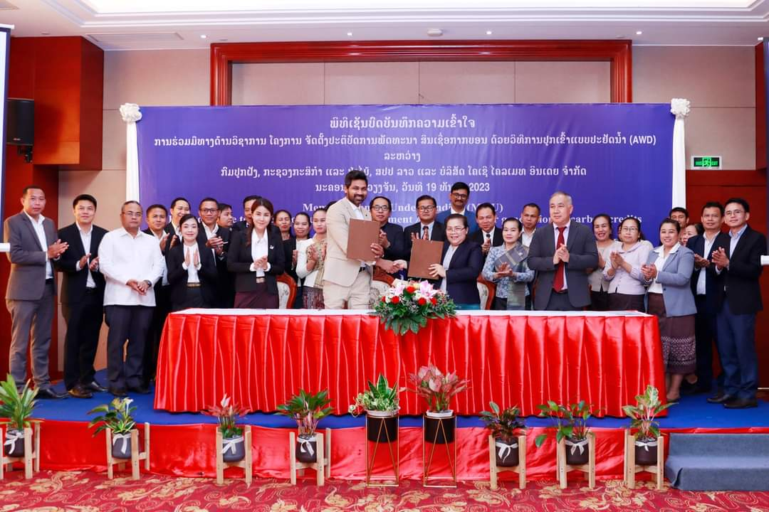
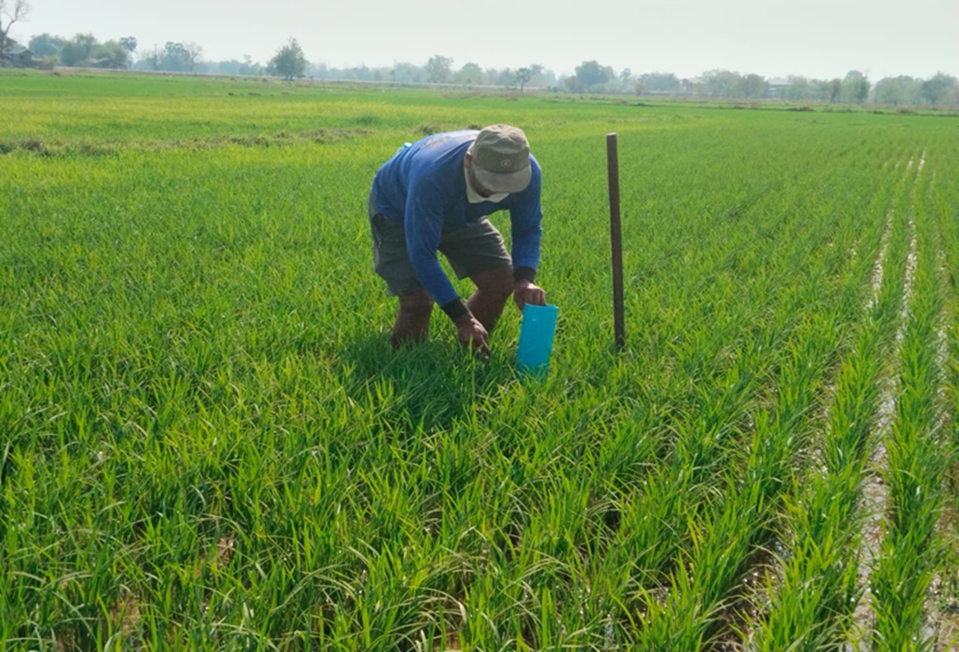
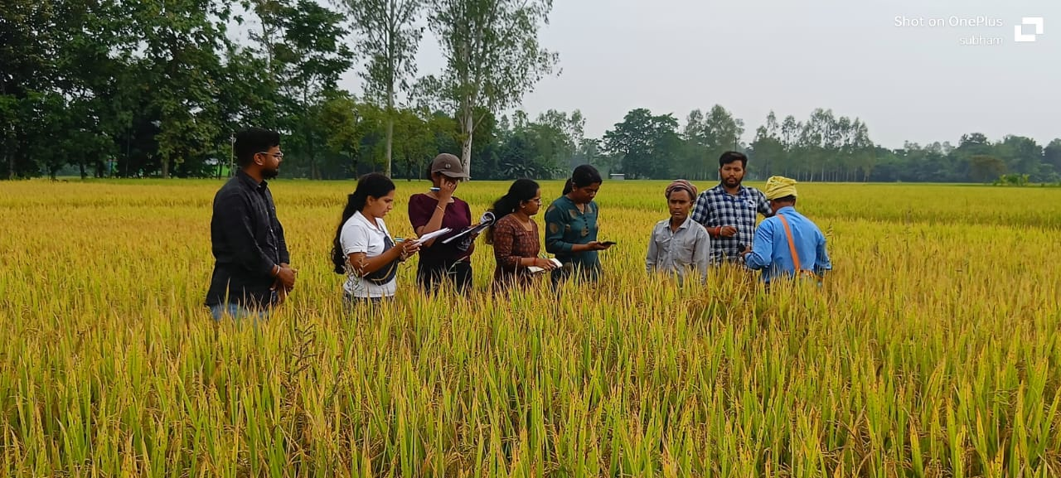
Glimpse of Our Journey
Challenge
Region evidence
Signing of MoU with Department of Agriculture, Govt. of Lao PDR
Mitigation measure & impact
Lao PDR AWD
Telangana, India AWD

