Slide 1

Forest carbon markets and the issue of ‘sovereign carbon’
Alain Karsenty
Economist, specialist in economic instruments for climate and biodiversity
alain.karsenty@cirad.fr

Slide 2
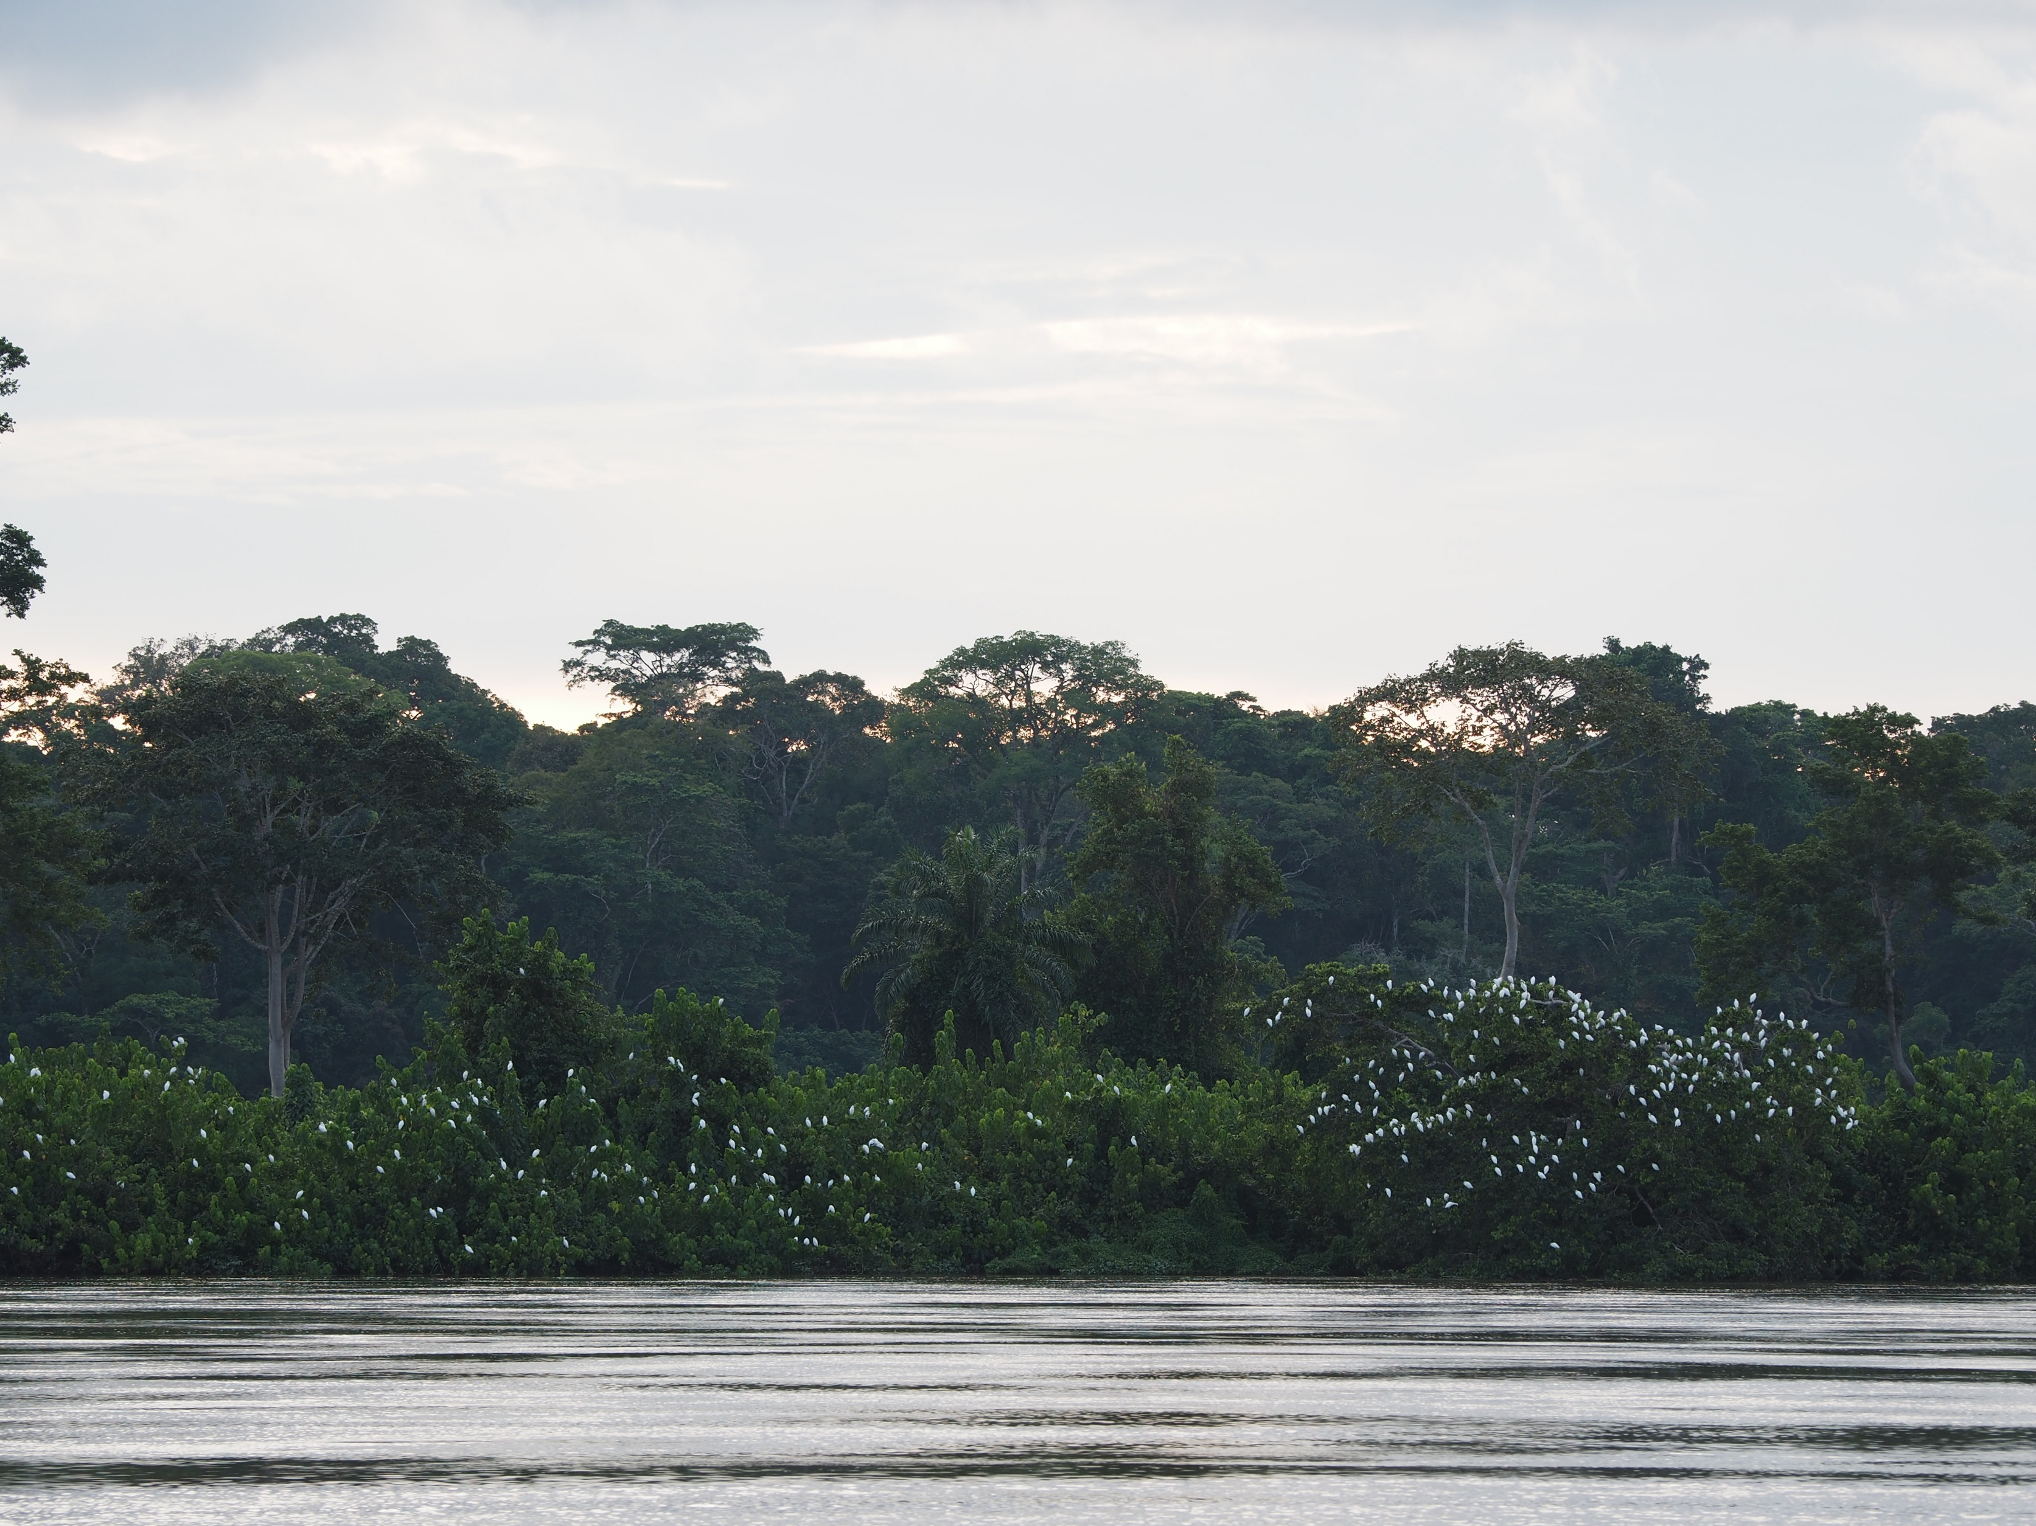
Introduction
Carbon credit markets have raised high expectations in developing countries for financing forest conservation and management, as well as afforestation.
However, the mere fact that a country or a community has forests (and therefore stored carbon) on its territory does not guarantee that it will be able to trade carbon credits.

Slide 3
The issue of ‘environmental integrity’
If we wish to offset (neutralise) emissions, additionality is a necessary condition, but one that is difficult to demonstrate or verify
CO₂e is a stable molecule in the atmosphere. It is absorbed by natural (terrestrial and oceanic) or technological ‘carbon sinks’, which remove it from the atmosphere and then store it in carbon reservoirs (e.g. biomass, soil).
  According to the IPCC, its residence time is ‘multiple’ and a significant fraction (15–40%) of emitted CO₂e remains in the atmosphere for many centuries (over a thousand years).
  “Offsetting” anthropogenic emissions therefore requires “additional” storage via anthropogenic sinks (to balance the emissions) over a very long period: a problem that is difficult to overcome through forestry (or agricultural) activities
The risk of leakage exists at various geographical scales and cannot be resolved without controlling global demand for land and for products derived from land conversion.
Lifetime of CO2 emissions — “15 to 40% of an emitted CO2 pulse will remain in the atmosphere for longer than 1,000 years, 10 to 25% will remain for about ten thousand years, and the rest will be removed over several hundred thousand years.” — IPCC, Climate Change 2021: The Physical Science Basis, 6 August 2021

Slide 4
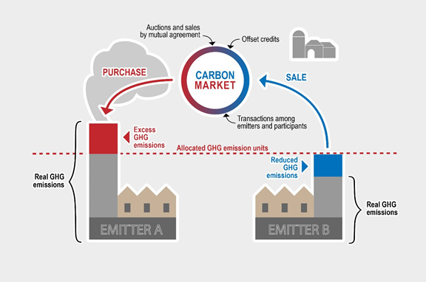
Distinguishing between cap-and-trade markets and project-based mechanisms
Cap-and-trade systems are based on rationing and use allowances or quotas (emission permits)
Project-based mechanisms have no emissions cap but use baselines, and projects generate credits
  Depending on the rules adopted by different jurisdictions, credits may (or may not) be used, and only to a certain extent, as emission permits
Simplified diagram of a cap-and-trade mechanism

Slide 5
Three scenarios for projects and forest carbon credits
Relative reduction
(‘avoided deforestation’)
Absorption/increase
in stock
Absolute reduction
Reductions must be attributed to actions (projects) or policies and measures (national).
“The past predicts the future BAU”
An “absolute reduction” is not proof of additionality
The reference scenario is a prediction, a counterfactual scenario that cannot be verified ex ante.
REDD+ activity but excluded, in principle, from Article 6
May result from plantations or ‘enhanced conservation’
Must be attributed to measurable actions or policies.

Slide 6
Quotas and credits do not have the same value
Increasing rationing is driving prices up
On the voluntary markets, old vintage credits cause very low average prices
Year to date
COMPLIANCE MARKETS
European Union | €79.06 | -15.35%
UK | $59.22 | -29.71%
Australia (AUD) | US$26.62 | +1.24%
New Zealand (NZD) | US$31.57 | +12.82%
South Korea | US$6.99 | +38.46%
China | ¥97.00 (US$0.61) | +33.11%
VOLUNTARY MARKETS
Aviation Industry Offset | $0.23 | +227.78%
Nature Based Offset | $0.85 | +240.00
Source: carboncredits.com (16/07/2026)

Slide 7
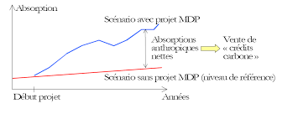
An initial phase of integrating forestry projects into a compliance market: the Clean Development Mechanism
Stemming from the Kyoto Protocol, the CDM was project-based and enabled the generation of carbon credits from afforestation and reforestation in developing countries
    Few afforestation/reforestation projects registered: lack of additionality (large projects) or excessively high transaction costs (small projects)
    The CDM ended in 2020, but several hundred credits are still available for sale
‘Avoided deforestation’ and ‘forest management’ activities were not eligible (COP 6,2000)
    The issue of ‘leakage’ was put forward as a reason for rejecting ‘avoided deforestation’ projects
    Doubts regarding additionality led to the exclusion of ‘forest management’
  PACM (Article 6) less restrictive

Slide 8

The REDD+ initiative
A proposal to pay for ‘avoided deforestation’, under negotiation since 2005
    Results at national level, not at project level (to prevent leakage)
  Gradual expansion of the scope of eligible activities: REDD+
  Principle of ‘results-based payment’, with or without recourse to the carbon market
  Opening up to the sub-national (jurisdictional) level
Rules adopted in 2013 (Warsaw Framework), but funding is mainly public (primarily from Norway)
Countries with high forest cover and low deforestation are not getting their fair share and are calling for ‘adjusted scenarios’ or forms of remuneration for existing stocks (‘past efforts’)
  A fraction of the stocks can be eligble under the ART-TREES standard (to be used by CORSIA, civil aviation)
REDD+ to be largely integrated into new markets 6.2 and 6.4, but do not overlook the dimension of “ODA financial transfers under the guise of REDD+” (which has been the dominant modality since 2005)

Slide 9
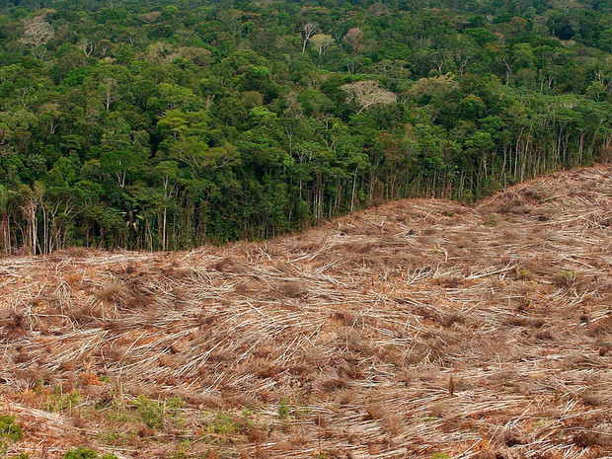
REDD+ projects, private initiatives
Corporate demand for credits (achieving ‘net zero’, beyond any regulatory obligations): voluntary market
The legal framework for REDD+ is unsatisfactory for carbon investors and NGOs (no direct trading of credits)
Private governance (certification standards)
Funding opportunities for forestry projects, but questions regarding the environmental integrity of the credits issued: market reversal, increasing selectivity among buyers
    Doubtful additionality, linked to the construction of reference scenarios
    Risk of ‘off-site’ leakage
    Does the ‘pooled credit reserve’ system provide a sufficient response to the problem of non-permanence?
  Criticism regarding land grabbing and the exclusion of communities (particularly when protected areas are taken over through carbon finance)

Slide 10
A new international ‘compliance’ market
Article 6 of the Paris Agreement establishes two mechanisms for transferring results or credits (PACM – Paris Agreement Carbon Markets)
    6.2: transfers of national results
    6.4: transfers of results from ‘Paris Agreement-aligned’ projects, with a ‘Supervisory Body’ regulatory body, albeit with limited powers (no possibility of rejection)
Clause for corresponding adjustment of results in the event of a transfer (results deducted from the NDCs of the countries selling or hosting the projects)
  For 6.2, the principle of additionality is mentioned but contradicted by the de facto abandonment of additionality in relation to NDC commitments (transfer of results beyond unconditional targets)
  Bridges provided for to integrate certain credits certified by voluntary standards, subject to corresponding adjustment and cancellation of 2% of credits (OMGE)
  Unadjusted or unauthorised credits are considered Mitigation Contribution Units

Slide 11
CASE |  |  |  | Example
1 | Host country | ITMOs (Internationally Transferable Mitigation Outcomes) | Purchasing country | Switzerland purchases ITMOs from Peru Peru must deduct these emission reductions from its balance sheet
 | Adjustment (-) | Projects / Allowances at the level of states or sub-national jurisdictions Article 6.2 | Adjustment (+)
2 | Host country | IMPs (International Mitigation Purposes) | Non-state entity | E.g.: the civil aviation sector (CORSIA initiative) has decided to offset part of its emissions by purchasing carbon credits
 | Adjustment (-) Adjustments will need to be made across all sectors, whether or not they are included in the NDCs | Article 6.4 Public or private entities | Emissions offsetting
3 | Host country | OP (Other Purposes) | COMPANIES | Projects (including emissions reductions from deforestation, removals by forests and/or in soils)
 | Adjustment (-) | Article 6.4 Public or private entities | Emissions offsetting | Forestry activities must be ‘aligned with the Paris Agreement’ (different from the Warsaw REDD+ framework), must be validated by the Supervisory Body) Final decision on ‘emissions avoided’ expected (2028)
4 | Host country | Voluntary market | COMPANIES | Avoided deforestation projects (in principle, not eligible under Article 6)
 | No adjustment, unless desired | Excluded from Article 6 | Offsetting of emissions beyond regulatory requirements (e.g. for carbon neutrality claims)

Slide 12
The expectations of developing countries
Specific requests from HFLD (High Forest Cover, Low Deforestation): being allowed crediting part of the stock using the ART TREES standard (used by Guyana)
The emerging theme of ‘sovereign carbon’
  Several possible interpretations
      Gabon pre-transition: national outcome (public policies), no projects
      The state as the sole buyer and seller of certified credits generated by projects
      Nested approach whereby projects can only sell on the market if the sum of their results remains below the national result
      Credit sharing or project taxation
      Credits may only be used within the national territory

Slide 13
Six possible options relating to sovereign carbon and carbon markets
‘Nationalised sovereign credits’
‘Exclusive sovereign credits’
“Nested approach”
‘Laissez-faire and share’
‘National targets and the domestic market’
“LULUCF Cap-and-Trade (land sector)”
Only national results are taken into account, and the state is the sole seller
Projects cannot generate carbon credits, but may be subsidised by the government.
Sale of ITMOs under Article 6.2 or of carbon credits on the voluntary market.
Only national results are taken into account, and the State is the sole buyer
Projects may generate carbon credits; the State is the sole purchaser and sets the purchase price for the credits.
Sale of ITMOs under Article [...], or of carbon credits on the voluntary market.
Projects, jurisdictional programmes and national results are taken into account.
Projects and/or jurisdictional programmes (JP) may generate carbon credits and be sold under Article 6.4 (i) if the results can be attributed to each of them, (ii) if the national result is greater than the aggregated results of the projects/jurisdictional programmes.
Non-attributable results are the property of the State
An adjustment is required if Article 6.4 credits are transferred internationally.
Projects are free to sell and transfer carbon credits on the voluntary or compliance market (6.4).
The government levies a tax on profits from carbon sales or requires a fixed percentage of carbon credits.
No adjustment is required for sales on the voluntary market (it is not mandatory), but if the government wishes to sell ITMOs under Article 6.2, it could be criticised for double counting.
Project results cannot be sold on the international market, but credits can be purchased by domestic companies to meet their reduction targets.
The government may sell ITMOs for other domestic results (not attributable to projects)
The UTCATF sector is disconnected from other sectors.
Instead of CO₂ , forest area (hectares) is used as an indicator.
A deforestation cap is set at national level and transferable deforestation rights (TDRs) are allocated to agro-industrial companies holding legal titles,
.
Establishment of a register for the trading of TDRs between companies
The government can then sell ITMOs if results are verified.

Slide 14
Effects of the corresponding adjustment rule
PACM carbon credits issued in one country (e.g. in Africa) and transferred to another country cannot count as emission reductions for the host country nor be traded by that same host country.
Credit transfers must be authorised by the host country
In Kenya (2026), the government refused to sign a letter of authorisation for the 15 million carbon credits from Koko Networks (bioethanol stoves)
KN went bankrupt due to insufficient market opportunities and prices in the voluntary market
What was previously a hypothesis (countries opposing the transfer abroad of carbon credits from private projects in order to be able to sell sovereign credits) is now becoming a reality.
Theoretical example: if Kenya achieves a result of –40 Mt of CO₂ in 2030, and the Koko Networks programme claims to have avoided 35 Mt of CO₂ emissions in 2030 (having had an equivalent number of credits certified and sold them abroad), Kenya can only report (and, potentially, sell abroad) a result of –5 Mt.

