Slide 1

High Integrity Carbon Markets in Agrifood Systems
Ivano Assenza – Technical Lead, Carbon Markets/Article 6 of the Paris Agreement
Ivano.Assenza@fao.org ​
​​
Learning Event: Webinar Series II: Carbon Credits in Agriculture – From Frameworks to Field Implementation

Slide 2






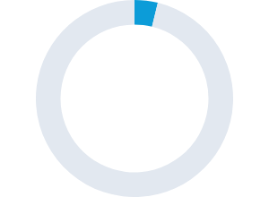
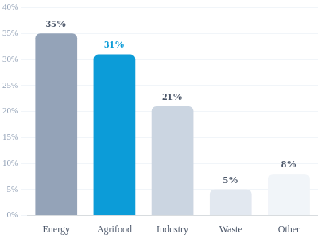




What are the gaps?
The Mitigation Finance Gap
2nd-Largest Emissions Source
NDCs
Despite severe underfunding, the sector is a massive contributor to global greenhouse gas emissions.
Agrifood systems are central to Nationally Determined Contributions (NDCs) for most countries, yet they lack the necessary capital to implement meaningful mitigation and adaptation strategies.
3.8%
Agrifood Share
Carbon Markets
Agrifood systems receive a vastly disproportionate share of global climate mitigation finance.
Carbon markets present a catalytic financial mechanism to bridge this gap. By establishing robust readiness infrastructure, capital can be driven directly to high-integrity agriculture and forestry projects.
SOURCE: Climate Policy Initiative, 2025
"Agrifood systems remain critically underfunded, receiving only 3.8% of mitigation finance, despite being the second-largest source of emissions."
Climate Policy Initiative, 2025

Slide 3
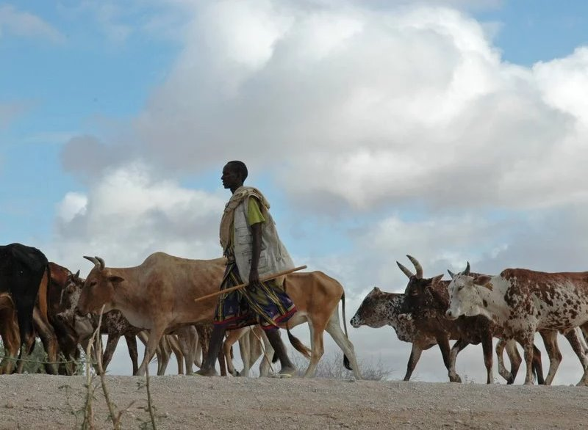
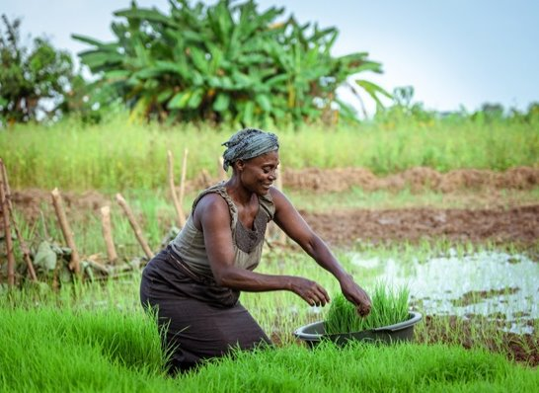
Article 6 after SB64 (Bonn): From Rulebook to Implementation
Key developments since our previous webinar
Countries are moving from planning to implementation
Establishing Designated National Authorities (DNAs), authorization procedures and registries
Developing institutional arrangements and ITMO accounting systems
Environmental integrity is now the priority
Stronger focus on additionality, conservative baselines, permanence and robust MRV
Greater emphasis on transparency, corresponding adjustments and avoiding double counting
Capacity building remains the biggest challenge
Countries continue to require support to strengthen governance, technical capacity and national readiness
Notes:
Key message
Article 6 is no longer about whether countries will participate, but how they can participate with high environmental and social integrity.
(Bottom right - small FAO message)
Implication for FAO: supporting countries to build the enabling conditions needed to access high-integrity carbon finance.
"The key message from the Bonn Climate Conference is that Article 6 has entered a new phase. The international rulebook is largely in place, and countries are now focused on implementation. This means developing national governance systems, authorization procedures, registries and robust transparency frameworks. At the same time, Bonn reaffirmed that environmental integrity and country readiness are fundamental prerequisites for attracting credible climate finance."

Slide 4

Why does this matter for Agrifood Systems and Public Development Banks?
Agrifood systems are central to climate action
Account for approximately one-third of global greenhouse gas emissions
Offer significant mitigation and adaptation opportunities
Remain considerably underfinanced despite their climate importance
Carbon markets can help mobilize additional climate finance...
…but only if countries have:
✔ Robust MRV systems
✔ Strong governance and institutional capacity
✔ Clear alignment with Nationally Determined Contributions (NDCs)
✔ High environmental and social integrity
Public Development Banks can play a catalytic role
Finance country readiness
De-risk climate investments
Aggregate smallholder projects
Mobilize private capital
Scale high-integrity agrifood carbon projects
Notes:
Carbon markets are not an objective themselves—they are one financing instrument to accelerate resilient, low-emission agrifood systems.
"For agrifood systems, this creates a major opportunity. Nearly all countries recognize agriculture within their NDCs, yet the sector continues to receive only a small share of climate finance. Carbon markets can help bridge part of this financing gap, but only where enabling conditions exist. This is where Public Development Banks become critical partners—not only financing projects, but financing the readiness needed to make those projects successful."

Slide 5
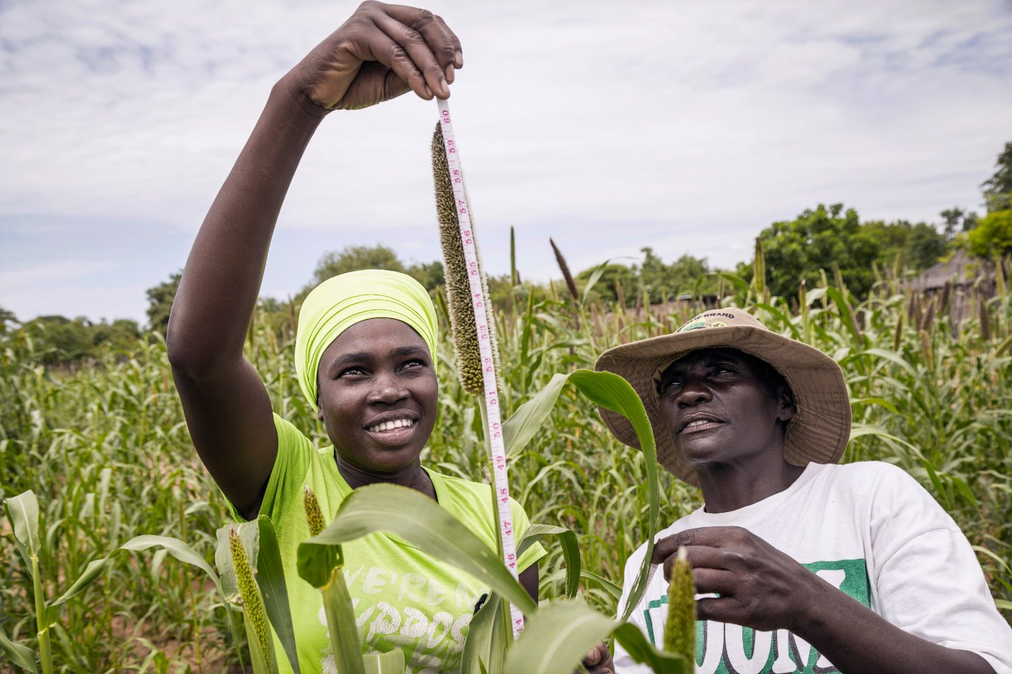
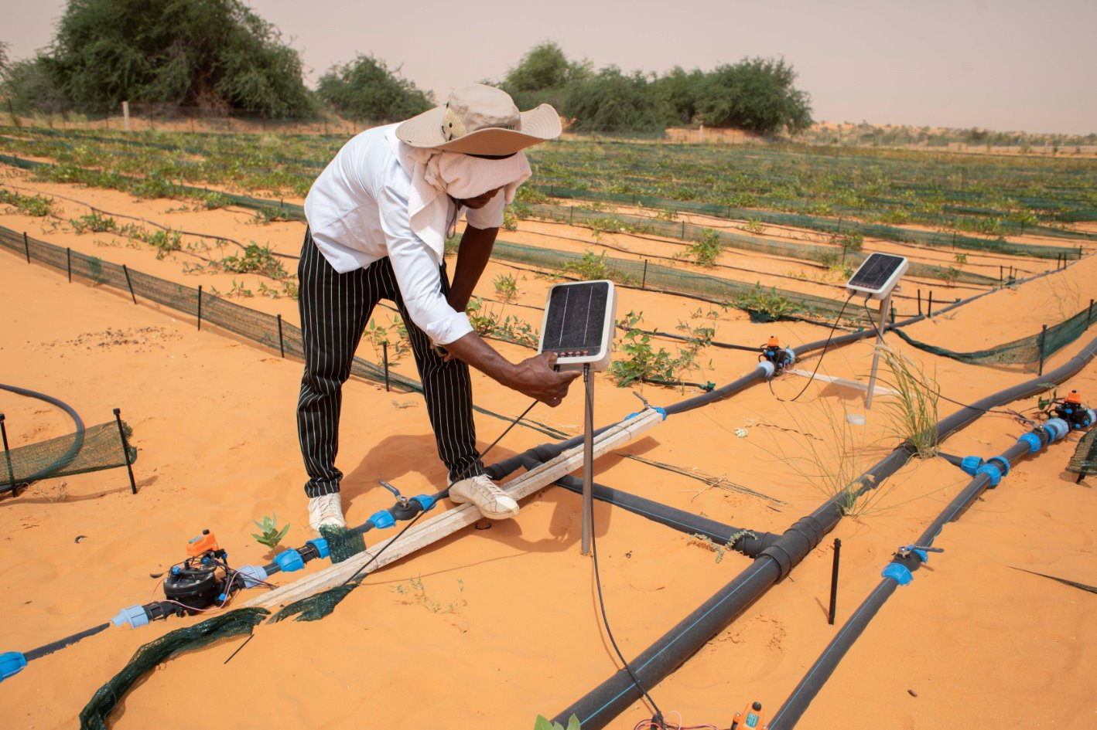
Three Key Takeaways
1. Readiness comes before carbon credits
High-quality projects require strong national institutions, policies, MRV systems and governance.
2. Integrity creates trust
Environmental integrity, transparency, safeguards and fair benefit-sharing are essential to attract long-term investment.
2. Partnerships unlock scale
Public Development Banks, governments, FAO and the private sector each have complementary roles in transforming climate ambition into bankable agrifood investments.
Notes:
Carbon markets are not an objective themselves—they are one financing instrument to accelerate resilient, low-emission agrifood systems.
"These three messages provide the foundation for the rest of today's webinar. We will now move from the policy and financing landscape to practical implementation, where our next speakers will demonstrate how high-integrity carbon projects are designed, financed and implemented in practice

Slide 7
Pillar One: FAO Country Level Support – Four Steps Framework
GUIDING THE JOURNEY FROM COUNTRY READINESS TO IMPLEMENTATION
Baseline Assessment
Capacity Building, Engagement
Technology, MRV, integrity Principles
Increase Country Credibility, Protect Sovereignty
Agrifood systems landscape - Mitigation potential
Stakeholder Mapping
Legal/Regulatory/Technical/MRV Review
GHG Inventory Accounting/ETF Review
NDC Roadmap alignment
Agrifood systems training Programs and Workshops
Facilitate Joint Inter-institutional Taskforce
Guidelines for project and methodological assessment
Address technical gaps
Build from established baseline
Institutional Integration
MRV Tools/Methodologies
Climate-Smart Technology
Safeguards, Fair benefit sharing
Carbon rights/FPIC
Indigenous Peoples
Women and Youth
Farmer centeredness
Strengthen market integrity and country credibility
Article 6 Price Transparency
Risk assessment
Due diligence guidance
NDC Reporting
Intermediary link between buyer and host country
Objective: Establish processes, MRV and embed integrity principles into institutional frameworks
Objective: Identify environmental, technical, institutional, regulatory baseline
Objective: Strengthen institutional, technical, regulatory capacity to address gaps
Objective: Help the country make informed decisions and ensure increased ambition through article 6 cooperation
REVIEW AND ASSESS
EMPOWER & IMPLEMENT – CREATE ENABLING ENVIRONMENT
CLIMATE FINANCE

