Slide 1
The Role of The Landbank Insurance Company in advancing agricultural insurance in South Africa
Agri-PDB Platform Working Group on Rural Financial Inclusion Panel Discussions
Andries Mahlase
14 July 2025

Slide 2
Agenda
The landbank
LBIC and LBLIC
Global insurance premium – Crop Indemnity 2023
Global insurance premium – Crop index 2023
Overview of crop insurance in South Africa
Landbank insurance products
Landbank Bancassurance approach
Conclusions

Slide 3




The Landbank
The Landbank is a wholly government owned specialist bank with the objective to serve South Africa’s farmers by offering customized financial services within their reach. The Landbank has over 100 years, experience and expertise in the Agricultural Sector. The Bank is a key player in the sector and the economy through promoting inclusive growth, transformation, employment and food security, whilst supporting established commercial farmers, developing emerging farmers and agri-enterprises
OUR BUSINESS STRUCTURE
Insurance Solution
The Landbank Insurance Company is a
subsidiary of the Landbank and provide
short term insurance, as well as credit life
insurance products to Land Bank clients and
farmers for the past 70 years
Corporate Banking and Structured Investment
Commercial Development and Business Banking –
• Offer direct lending financial solutions to small and emerging farmers via an extensive provincial network.
• Offer direct lending solutions through partnerships with agribusinesses or corporates.
• Provide wholesale funding facilities to intermediaries that on-lend to smallholder farmers
Provide debt, structured finance and equity solutions to agribusinesses.
Total Loans disbursed by the Bank in 2013, 2020 and 2025 = R27 bio, R45bio and 15 bio respectively

Slide 4
LBIC and LBLIC
Are subsidiaries of the Land and Development Bank of South Africa.

Slide 5
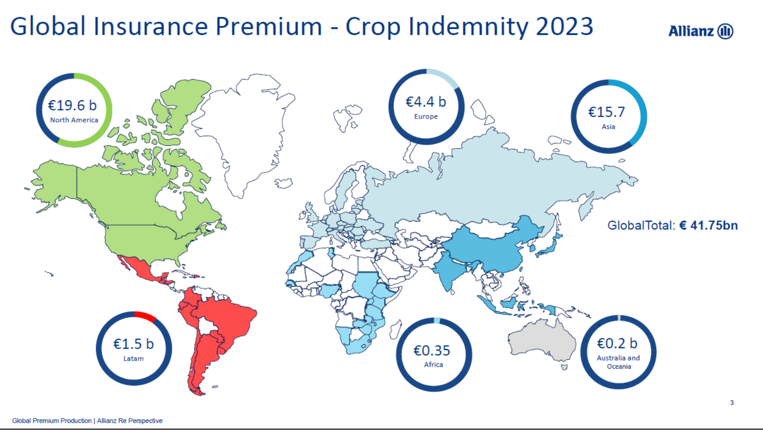
Contribution of Africa is less than 1% of the world with South Africa being a major contributor

Slide 6
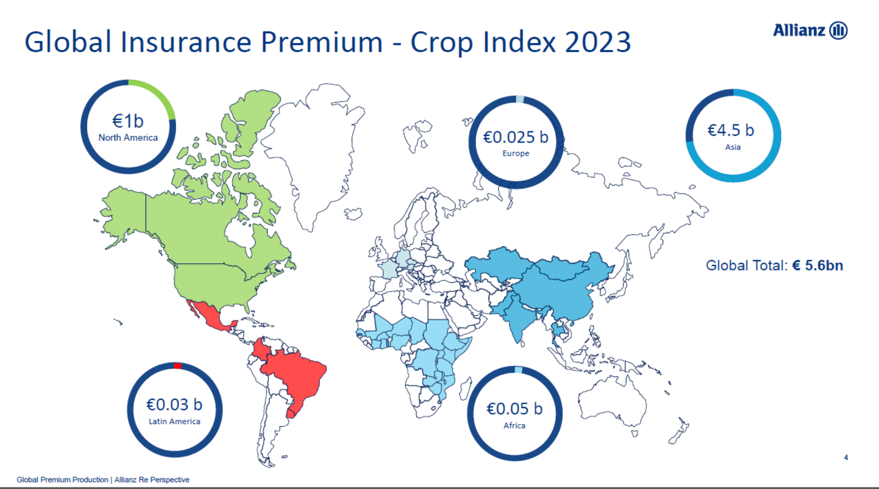
South Africa’s contribution to index insurance is zero

Slide 7
Overview of crop insurance in South Africa
  State of Crop Insurance
There are 5 crop insurers in the South African market – 4 private and 1 state owned
The South African Crop insurance market is roughly R2.6 mio or $150 mio by premium. Landbank is the second biggest player with a 33% market share.
Crop insurance is completely backed by the private sector with no government subsidies
Indemnity crop insurance products mainly (named perils such as hail, wind, frost, fire and limited transit) are offered and are geared for commercial farming operations.
MPCI which serves as collateral security preferred by banks is offered on a very limited and restricted basis by Reinsurers.
Parametric insurance products are generally not offered, unless on a prior pilot, prior approval basis by the Prudential Authority. So far only two insurers including Landbank are approved to pilot parametric insurance in South Africa.
Only a third of the 35,000 commercial farmers are insured in South Africa
Less than 1% of Small holder farmers.
  Challenges to adoption of insurance in South Africa
  South Africa is prone to cat events such as hail storms, flooding, drought and disease outbreaks that threatens the sustainability of the sector.
  Reliance on government’s post ante disaster relief and recovery mechanism.
  Available products are geared for commercial farmers only.
  Low insurance knowledge amongst smallholder farmers
  Limited availability of reliable data for modelling and pricing risks.
  Prohibitively expensive insurance products for farmers.
  Lack of sufficient infrastructure (administration and loss assessment) to support smallholder farmers

Slide 8
Landbank Insurance products
Traditional products and Innovation: Parametric (Index) Drought Insurance
LBIC offers insurance through intermediaries and through a Banc assurance model for business originating internally from the bank
LBIC Clients are mainly individual farmers, farming enterprises and Landbank Clients
Insurance products are :
- Named Indemnity products such as hail, frost, fire and limited transit for Commercial farmers
- Credit life insurance for commercial and smallholder farmers
- Pasture drought Index (PDII) and Area Yield Index AYII for smallholder farmers since the 2024 summer season
During 2024, the Prudential Authority granted LBIC permission to pilot a Livestock Pasture Drought Index Insurance (PDII), and a Crop Area Yield Index Insurance for two season, from October 2024 to November 2026’
LBIC, has in partnership with CelsiusPro and with support from IFC, been actively involved in the development of these products.
A small PDII successful pilot project was launched during the 2024 summer season. Both the PDII and AYII will be piloted during the 2025/26 season targeting 2 500 smallholder farmers
  Pasture Drought Index Insurance (Normalised Difference Vegetation Index - NDVI):
  The forage deficit coverage program is currently in its pilot phase, being implemented across a number of provinces.
  The product first launched in 2024 summer season, was successfully implemented, although with a limited number of policies issued.
  During the 2024/25 agricultural season, pasture conditions across the insured municipalities were notably positive.
  The second pilot phase is planned for the 2025/26 production season
  Area Yield Index Insurance:
  Area Yield Index Insurance provides seasonal coverage against systemic risks such as drought by compensating farmers when average yields in a defined area fall below historical norms.
  2025/56 Pilot will be on Maize and Soya Beans
  Historical yield data obtained from the department of Agri.
  Ground truething through crop cutting experiments to confirm yield loss.

Slide 9
Landbank Bancassurance approach
Key Focus Areas

Slide 10
Conclusions
Agricultural insurance is a very important instrument in mitigating climate risks for farmers
It is enables financial access as it is an important collateral security for farmers.
Established commercial farmers have access to indemnity insurance products and other financial instruments.
The landbank insurance company is enabling smallholder farmers through financial education in order to create awareness.
The partnership with Celsius Pro and the IFC is supporting development of parametric products for smallholder farmers
The Landbank Insurance Company will in partnership with the South Africa Insurers Association and other partners, continue to collaborate with policy makers in order to promote public-Private Partnerships in Agricultural insurance.

Slide 11
Thank You!

