Slide 1
Agri-PDB Platform
14 July 2025
Strengthening Rural Financial Inclusion through Climate Risk Insurance:
IFAD’s Approach and Lessons from INSURED

Slide 2
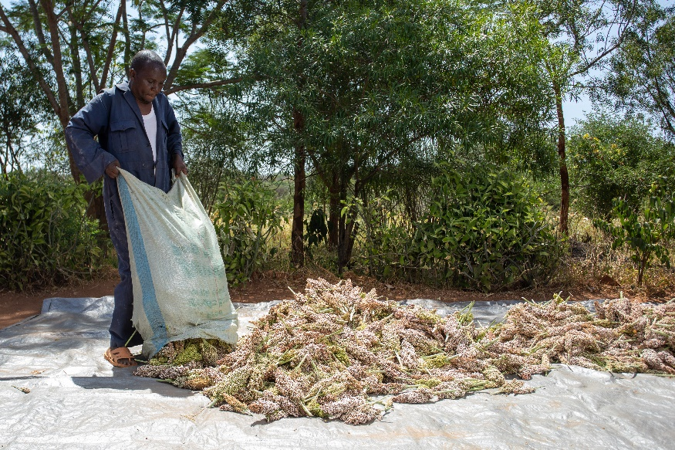
Why Insurance Matters for Inclusive Finance
Climate extremes are intensifying, increasing uncertainty for rural livelihoods
Small-scale producers are highly exposed, often facing devastating crop or income loss
Unmitigated risk deters investment by farmers, lenders, and value chain actors
Building resilience requires layered strategies – and insurance is one tool
The goal isn’t just protection—inclusive insurance helps build systems rural communities can trust, understand, and use. This is where PDBs can lead.
Notes:
Message: Climate shocks are intensifying—putting smallholders at greater risk and limiting access to finance
As climate risks grow, small-scale producers are on the front lines. When their crops fail, it's not just a bad season—it's a major shock to their income and food security. Without protection, they pull back on investment. And when risk isn’t managed, neither farmers nor lenders can plan with confidence. That’s why risk management must be integrated into how we think about resilience and rural finance

Slide 3













INSURED: Making Inclusive Insurance Work
Structured technical assistance. Scalable results.
Results: Phase I (2018-2023)
Technical assistance and design support to a total of
28 projects and programmes
supported by IFAD
and partners.
About 630,000 rural people
protected under climate
risk insurance policies.
About 150,000 insurance policies
purchased with a
Total Sum Insured for all policyholders of
US$24.1 million.
US$11 million
leveraged in new financing for insurance workstreams through support to design of new IFAD-funded projects and programmes.
Women account for over 50%
of small-scale producers
covered by insurance through risk transfer pilot schemes.
About 73,000 small-scale producers
received payouts
worth about
US$3 million.
Over 23,000
rural people trained in financial literacy
and use of insurance
products and services.
Future outlook: INSURED II (2025-2027)
Demand-driven technical support in climate risk insurance solutions
Scaling up inclusive insurance solutions to de-risk public and private investment in agriculture
Expanding global action on climate risk insurance by fostering international dialogue
Global technical assistance through IFAD portfolio & key strategic partners
Notes:
This is what the first phase of INSURED achieved — and why it worked. It combined tailored technical support, delivery through IFAD platforms, and country-led partnerships.
TA programme by IFAD, funded by Sida, implemented via PARM
Worked across 18+ countries with smallholders, PDBs, cooperatives
Technical assistance for product design, strategy, capacity-building

Slide 4





Protecting small-scale producers in Kenya
A Replicable Model for PDBs
INSURED TA to integrate crop insurance with:
  Access to banking via e-wallets
  E-vouchers for subsidized inputs & services
  ‘Phygital’ training on finance & farming practices via IVR, SMS, ward agri officers
This model worked because insurance was:
  Embedded in IFAD’s KCEP-CRAL
  Bundled with goods & services
  Delivered digitally via public-private collaboration
107,455 farmers insured over 5 seasons
  58% women and youth
  ~90% reporting increased resilience
Farmers’ Account
Conservation Agriculture
Seed
Fertilizer
Insurance
Post Harvest Equipment

Slide 5
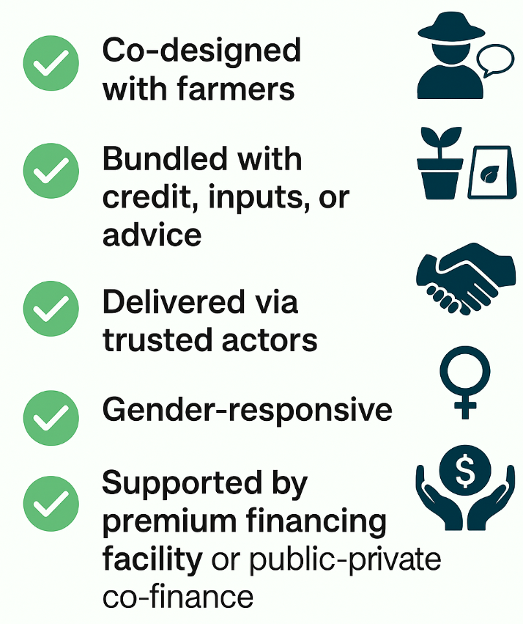
What Makes Inclusive Insurance Work
Key Features of Inclusive Insurance

Slide 6

INSURED Lessons Learnt
Demand
CRI reduces negative coping strategies by protecting incomes
Gender-sensitive farmer education supports insurance uptake, increased investment, and women's empowerment
Affordability remains a challenge
IFAD programmes offer ideal an ideal entry point to address supply and demand constraints while enabling scale
Combining insurance solutions with complementary services or products resulted in scalable insurance models for the hardest to reach
Insurance not always appropriate but can be part of holistic approach to rural development and de-risking investments in small-scale agriculture
Supply
Bundling works but innovations needed in distribution for scale-up
Coverage for multiple risks increase client value
Lack of data for informed decision-making
Enabling environment
Prioritize PPPs & govt buy-in
Nat’l schemes are great for scale but need long-term commitment,
Regulations do not always support best practices in bundling and distribution
Notes:
Implementation challenges to be mentioned while presenting

Slide 7
How can PDBs Make Inclusive Insurance Work?
Key Actions for PDBs
Appoint institutional champions
Demand-driven design
Targeted technical assistance
Build strategic partners
Long-term investment and ownership by the PDB
Key Benefits
Stabilize cash flow for borrowers
Reach more climate-exposed, rural clients
Improve repayment
De-risk lending portfolio
Notes:
Across countries and contexts, one lesson from INSURED is clear: insurance only works when it is understood, trusted, and rooted in local realities. In places like Kenya, we’ve seen that community engagement, bundling with services like extension support, and transparency in both data and design are not optional — they’re essential.
Inclusive insurance must be participatory to be sustainable. When it’s co-created with farmers, delivered through trusted actors, and embedded in rural finance ecosystems, it can unlock resilience at scale — and PDBs have a key role to play in making that happen

Slide 8
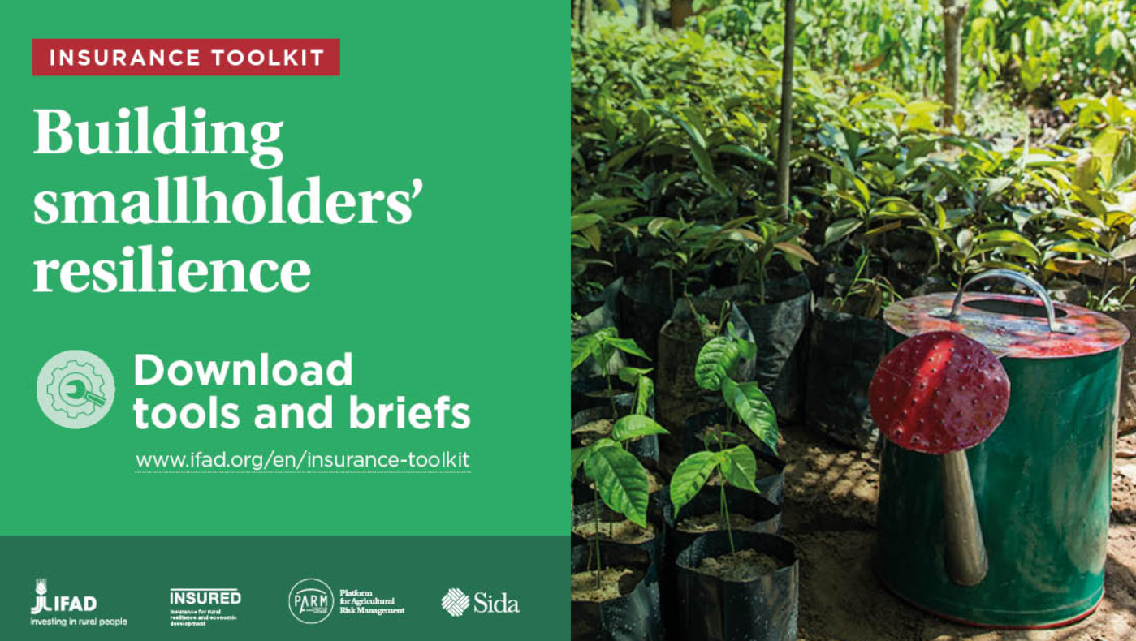


Thank you!
Contact us
insured@ifad.org
https://www.ifad.org/en/insured
https://www.ifad.org/en/insurance-toolkit

