Slide 1
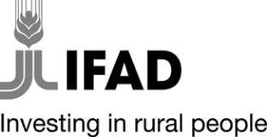

Rural Transformation Financing Framework (RTFF):
Unlocking Sustainable Private Capital for PDBs

Slide 2

Introducing the RTFF
A voluntary global public good financing framework focused on rural transformation and sustainable agricultural development.
Encourages industry best practices in:
Issuing impact-related, sustainable, or themed debt instruments such as loans and bonds
Development of Sustainable Finance Frameworks (SFFs)
Promotes investments in rural communities by providing:
Qualifying activities for investment
Potential indicators for impact reporting

Slide 3
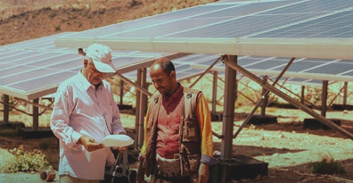
Why the RTFF Was Developed
Addresses a market gap in mobilizing private sector financing for rural transformation and food security in developing countries
Robust frameworks exist for green bonds, climate, Amazonia, but lack of financing frameworks for food security investments
Building on IFAD’s expertise and leadership in rural transformation and agricultural finance
To offer PDBs with:
Support in achieving SDGs by easing the development of rural transformation frameworks
A flexible, streamlined path to sustainable finance solutions aligned with national development

Slide 4



Who the RTFF is For
All potential borrowers/issuers
Investors
Other stakeholders
…International/national development financiers, private sector investors (banks, microfinance), local food systems stakeholders such as small producers and agribusinesses
…from traditional commercial banks and bond investors to impact investors and responsible investment funds
…specifically public and national development banks

Slide 5

Key Benefits for Public Development Banks
Promotion of sustainable development: Integrates environmental and social equity practices into financing.
Enhanced investor confidence: IFAD’s 50+ years of rural development expertise and RTFF alignment with international standards boosts credibility and trustworthiness.
Diversification of funding sources: Expands investor base and promotes innovative financing.
Cost savings: A ready to use, standardized framework reducing legal, administrative, and consultancy cost.
Time efficiency: Speeds up structuring and issuance using existing taxonomy and guidelines.
Flexibility and customization: RTFF can be adopted wholly or partially to fit national development strategies and specific needs.

Slide 6
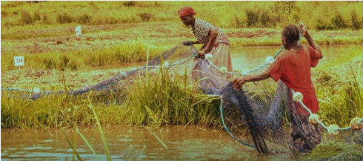


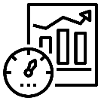
What does the RTFF include
How to use this framework
Taxonomy Compendium
Indicators – Measuring Impact
Identification of eligible qualifying investments for rural transformation rooted in key strategic intervention areas
Examples of potential indicators to help assess the outcomes of eligible qualifying activities for reporting purposes
Practical guide for issuers on how to develop an SFF

Slide 7

How to use this framework – A Step-by-Step Guide for PDBs
To help PDBs align financing strategies with international standards, ensure transparency, and communicate effectively with investors, the RTFF provides:
Clear Guidance for SFFs
Outlines key components of an effective SFF
Includes real-world examples to guide implementation
Alignment with International Standards
Adheres to the International Capital Market Association (ICMA) principles
Ensures compliance with recognized global sustainability benchmarks
ICMA’s 4 Pillars
1
2
3
4
Use of Proceeds
Defines eligible rural transformation projects (aligned with taxonomy & indicators).
Project Selection & Evaluation
Explains criteria, governance, and risk management processes.
Management of Proceeds
Ensures transparent tracking, allocation, and fund use.
Reporting
Covers impact and allocation reporting with clear indicators.

Slide 8
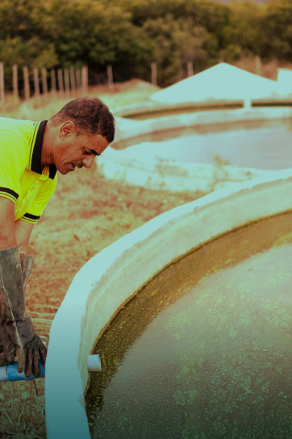
A Structured Pathway for Sustainable Rural Investment
Built on RTFF’s Four Guiding Principles, it defines key strategic intervention areas that align with rural development priorities and address real-world challenges.
Bridges strategy and investment by organizing these interventions into six major investment areas, representing the key domains for impactful financing.
Each investment area offers practical, qualifying activities that provide clarity on eligible projects and financing opportunities.
Aligned with global standards, with each activity mapped to relevant UN SDGs, ICMA GBP & SBP, and IFAD’s Core Indicators Framework.
Provides potential indicators to help assess the impact of eligible qualifying activities under the RTFF for impact reporting purposes.

Slide 9
RTFF’s Four Guiding Principles
The RTFF is built on four key principles which form the foundation for defining the broader strategic intervention areas.
These are designed to address critical challenges and to drive sustainable development within rural economies.
RTFF’s Four Guiding Principles
Sustainable infrastructure investments that will promote sustainable economic growth, improve living conditions, and ensure equal access to resources, infrastructure, and financial services for rural populations.
Environmental sustainability - sustainable agriculture that will strengthen and support agricultural value chains, climate smart solutions, and sustainable land and water management.
1
2
Effective governance, strong policy frameworks, and institutional capacity with the aim to improve service delivery, accountability, and public sector efficiency.
3
4
Exclusions - clearly defining ineligible activities to ensure proceeds are not directed toward projects or activities that conflict with climate goals, environmental preservation or social equity.

Slide 10






The RTFF’s Six Investment Areas
PROTECTION OF THE ENVIRONMENT AND NATURAL RESOURCES
ACCESS TO MARKETS
POLICY AND INSTITUTIONS
INCLUSIVE RURAL FINANCE
RURAL SERVICES AND INFRASTRUCTURE
PRODUCTION SECTORS

Slide 11
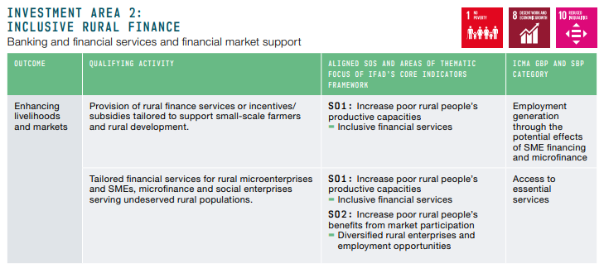
The Taxonomy Compendium
The Taxonomy Compendium offers a structured and standardized approach to identifying and classifying specific qualifying activities for investment, ensuring that financial flows are directed towards projects that meaningfully contribute to sustainable rural transformation.
Illustrative example:

Slide 12
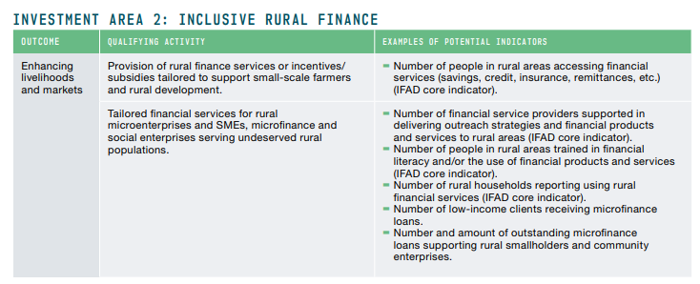
Indicators: Measuring What Matters
Reporting is a fundamental pillar of the ICMA’s guidance on the credibility of a labelled debt issuance.
PDBs can use the RTFF’s impact-reporting framework to measure, assess and communicate the social, environmental and economic impacts of their projects and activities.
Illustrative example:

Slide 13
Next Steps for PDBs
How to Engage with the RTFF – Practical guidance from CBI
Accessing the Framework – Availability as a global public good
Q&A and Open Discussion – Your questions and insights

Slide 14
Thank You

