Slide 1
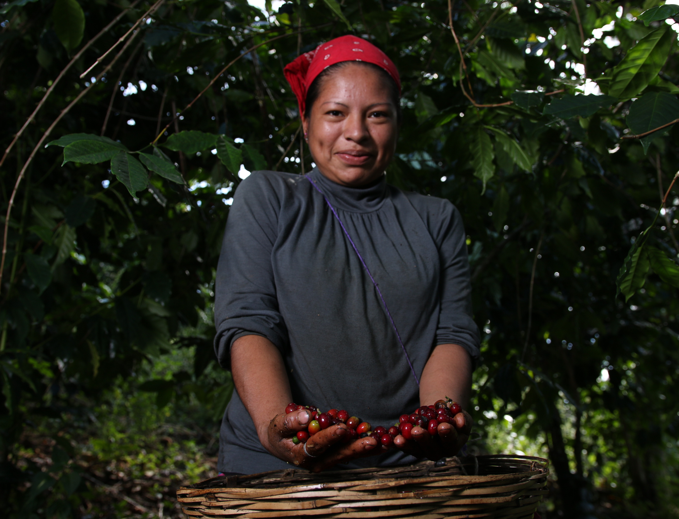
Climate Adaptation Bonds for Agriculture Resilience
Case: FIRA's green resilience bond
September 26th / 2024.

Slide 2
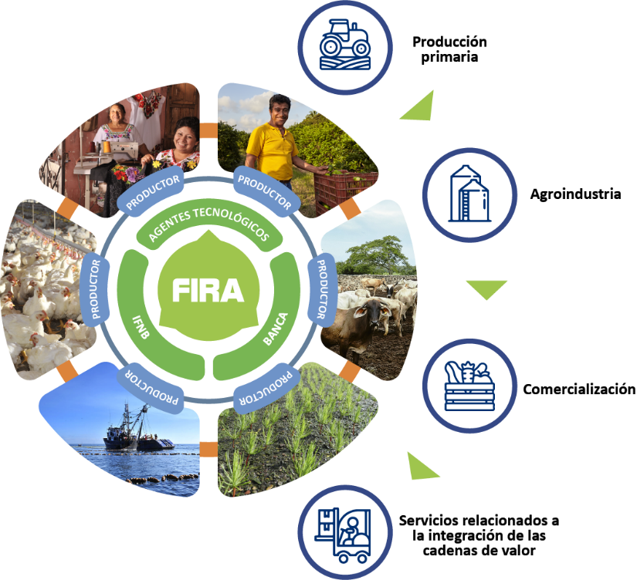
Created in 1954 by the Ministry of Finance (SHCP) and the Central Bank of Mexico (Banco de Mexico).
We support any agri-food sector related activity in any part of the country; and non-traditional activities in cities with less than 50,000 inhabitants.
Primary production
FONDO
Fondo de Garantía y Fomento para la Agricultura, Ganadería y Avicultura.
Fondo Especial para Financiamientos Agropecuarios.
Commercialization
FEFA
FEGA
Fondo Especial de Asistencia Técnica y
Garantía para Créditos Agropecuarios.
Agroindustry
FOPESCA
Fondo de Garantía y Fomento para las Actividades Pesqueras.
Value Chain integration
related services

Slide 3
As a second-tier Development Bank, our business model is supported by a Financial Intermediaries’ network, as the channel for financing producers and companies.
PROGRAMS
TECHNICAL SUPPORT
FUNDING
GUARANTEES
International financial organizations
Federal and State Government Offices
Private sector
Producers
Financial Intermediaries
Training
Advisory
Technology transfer
Strengthening
BANKS
NBFI
Productores, empresarios, comerciantes y proveedores
Producers, entrepreneurs, traders and suppliers

Slide 4
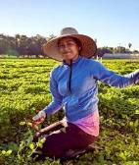
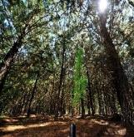

Priority Objectives
FIRA governs its actions with the 2020-2024 Institutional Program, which considers three priority objectives. Each one, with specific strategies and actions that contribute favorably to the attention of the agri-food sector and the rural population.
OP1
OP3
Promote financial inclusion and lower access barriers to financial services for producers, with an emphasis on smaller-scale ones.
OP2
Contribute to the development
of a responsible and sustainable agricultural, forestry and fishing sector.
Promote increased productivity and efficiency in all value chain links of the field.

Slide 5
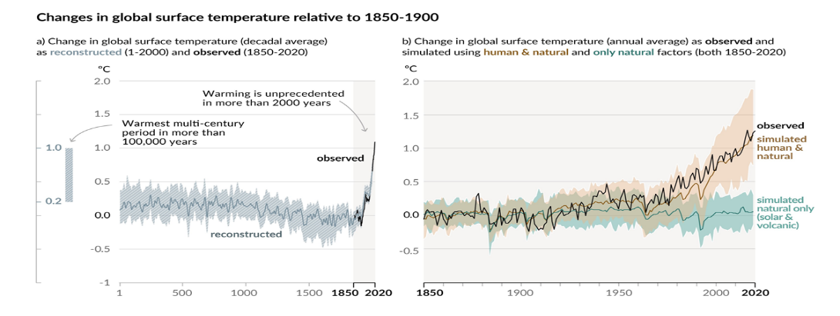
There is enough scientific evidence to affirm that the global temperature of the planet is increasing exponentially.
Climate change will affect agricultural production by negatively altering crop yields in the main producing areas.
This will mainly affect small producers who produce under rainfed conditions and who lack sufficient resources to adapt to new climatic conditions.

Slide 6
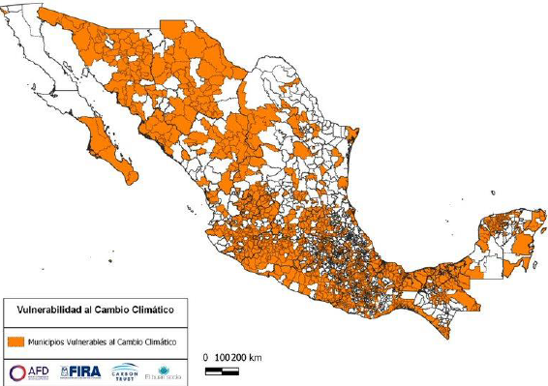
The effects of climate change for Mexico are expected to be greater than the global average, bringing sea level rise, ocean acidification, heat waves, extreme weather events, reduced precipitation, drought and wild fires.
1,448 Municipalities vulnerable to climate change
Given the evidence of the changes that are certain to occur, it is necessary to invest in adaptation to the effects of climate change.
To this end, the National Institute of Ecology and Climate Change developed the National Atlas of Vulnerability to Climate Change.
This atlas is a tool that analyses specific climate-related problems and aims to show the differential vulnerability of the territory considering current conditions and future scenarios.
Source: Own elaboration based on data provided by National Institute of Ecology and Climate Change of prioritised municipalities, 2019.

Slide 7






The taxonomy developed for FIRA on climate change adaptation and resilience uses two criteria: geographical location and investment concepts.
Investment concepts (a.k.a. types of projects)
Due to extreme weather conditions, FIRA undertook a series of actions to address the impacts of climate change, including the development of a taxonomy for climate change adaptation and resilience.
And in the Sustainable Taxonomy of Mexico (TSM) the climate change adaptation component is one of the environmental objectives.
Geographical location
1,448
89
Developed by:
Analysed and
supported by:

Slide 8
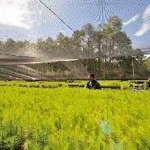
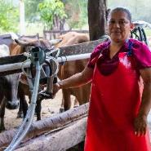
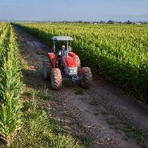
In the last 6 years FIRA has issued 10 thematic bonds for a total amount of $27,302 million pesos (ca. US $1,400 million), in the following categories:
Green bonds
Projects with environmental benefits for the agricultural and rural sector, and Green Resilience Bond
FEFA 18V
FEFA 19V
FEFA 20V
FEFA 23V
FEFA 23-2V
$2,500 (US $127.5 millions)
$2,500 (US $127.5 millions)
$3,000 (US $153.1 millions)
$2,985 (US$152.3 millions)
$1,090 (US $55.6 millions)
First Climate Resilience and Adaptation Bond
Gender bonds
Support women's economic autonomy
FEFA 20G
FEFA 21G
FEFA 23G
$3,000 (US $153.1 millions)
$3,500 (US $178.6 millions)
$3,000 (US $153.1 millions)
Social bonds
It facilitates access to and use of formal credit for small-scale producers.
$3,920 (US $200 millions)
$1,807 (US $92.2 millions)
FEFA 22S
FEFA 24S

Slide 9
Taxonomies of eligible projects
Category | Eligible categories
Green | 1. Sustainable management of natural resources and land use
 | 2. Sustainable agriculture and livestock
 | 3. Fishing and aquaculture
 | 4. Renewable energy
 | 5. Efficient and resilient water and wastewater management
 | 6. Energy efficiency
Adaptation and climate resilience | 1. Absorption to extreme climate events
 | 2. Adaptation to extreme climatic events
Financial inclusion | 1. Access to financial products and services for producers and enterprises in the agricultural, forestry, fisheries and rural sectors.
 | 2. Use of financial products and services for entrepreneurs, producers and/or enterprises in the agricultural, forestry, fisheries and rural sectors.
 | 3. Financial intermediaries that increase the supply of products and services that help lower barriers to financial inclusion.
Gender equality | 1. Financial Inclusion (New credit beneficiaries)
 | 2. Employment and productive initiative
 | 3. Entrepreneurship
Sustainable Bonds
Green bonds
Social Bonds
9

Slide 10
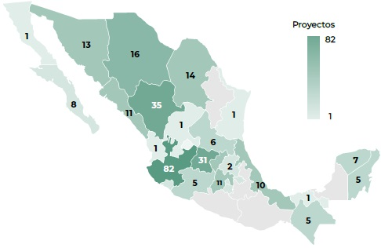
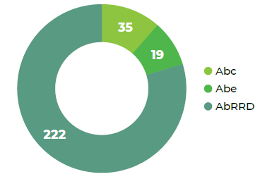
Results of the first resilience bond (April 2023 – April 2024).
Category | Number of funded projects | Credit granted (MXN millions) | Number of beneficiaries
Absorption of extreme climatic events | 206 | 2,625 | 238
Adaptation to extreme climatic events | 70 | 360 | 2,047
Total | 276 | 2,985 | 2,285
During the first year, 100% of the bond resources were allocated, amounting to 2.985 billion pesos benefiting 2,285 producers. The resources were distributed across the two categories of the taxonomy, with 88% allocated to the category of absorption of extreme climate events, and the remaining 22% to the category of adaptation to extreme climate events.
Geographical distribution and type of projects funded
Proyects
ABC: Community based adaptation
ABE: Ecosystems based adaptation
ABRRD: Reductin of dissasters based adaptation

Slide 11
Thank you
Erick Rodriguez Maldonado
Deputy director for the environment (erodriguez@fira.gob.mx)

Slide 12
Categories and KPIs of the First Climate Resilience and Adaptation Bond
Use of Proceeds Category | Eligibility Criteria | Key Performance Indicators
Absorption before extreme climate events | Credits for projects that help reduce or prevent the impacts from extreme climate events in the municipalities with highest vulnerability to climate change according to the climate change vulnerability assessment of INECC, in order to preserve and restore essential functions and structures in the agricultural, forestry, livestock, fishing, food and rural sectors. | Volume of credit granted to increase the absorption capacity to face the impact of extreme climate events. Volume of credit disbursed to increase the absorption capacity in municipalities with a vulnerability index of 2 and 3, according to the classification of the National Atlas of Vulnerability to climate change of the INECC. Number of beneficiary borrowers with increased the absorption capacity in the face of extreme weather events.
Adaptation to extreme climate events | Credits for projects that contribute to adjust, modify or change the characteristics of a productive system to better respond to climate change induced shocks and stresses in the agricultural, forestry, fishing, food and rural sectors, in the municipalities with highest vulnerability to climate change according to the climate change vulnerability assessment of INECC. | Volume of credit disbursed to increase adaptive capacity to the impact of extreme climate events. Volume of credit disbursed to increase adaptive capacity in municipalities with vulnerability index of 2 and 3, according to the classification of the National Atlas of Vulnerability to climate change of the INECC. Number of beneficiary borrowers with the productive systems with increased adaptive to withstand extreme climate events.

Slide 13
Taxonomía de adaptación y resiliencia al cambio climático de FIRA
89 conceptos de inversión
Concepto de Inversión Elegible
POZO PROFUNDO ADEME
EQUIPO BOMBEO POZO PROFUNDO
DRENES CONSTRUCCION
DRENAJE PARCELARIO
DRENES MANTENIMIENTO
DEPOSITOS DE AGUA
COSECHA DE AGUA PARA RIEGO AGRICOLA
EQUIPO DE BOMBEO
POZO PROFUNDO EQUIPO PERFORACION
POZO PROFUNDO PERFORACION
POZO PROFUNDO REHABILITACION
POZO PROFUNDO ESTUDIO/SONDEO
NORIAS
PRESA ALMACENADORA CONSTRUCCION
PRESA ALMACENADORA MANTENIMIENTO
PRESA DERIVADORA CONSTRUCCION
Concepto de Inversión Elegible
PRESA DERIVADORA MANTENIMIENTO
MANTENIMIENTO CONSTRUCCS E INSTALAC
GALERAS
CASAS CABAÑAS VIVIENDA RURAL
COBERTIZOS
CAMINOS INTERNOS EN EXPLOTACIONES
CAMINOS VECINALES
ESTACION CLIMATOLOGICA CONSTRUCCIO
FRIGORIFICOS
HORNOS
PUENTES
SANITARIOS RODANTES O FIJOS
SILOS
TANQUES
TOLDOS Y MALLAS PROTECTORAS
ZAHURDAS
Concepto de Inversión Elegible
PLANTAS Y GENERADORES ELECTRICIDAD
LABORATORIOS CONSTRUCCION
LABORATORIOS EQUIPAMIENTO
OBRAS DE CAPTACION DE AGUA
CORRALES
CARROS DE CAMPO
CLASIFICADORA SELECCIONADORA
COMPRESORES
DESGRANADORAS
EMPACADORAS DE FORRAJE
EQUIPO PARA ENSILAR
ESCREPAS
SISTEMAS DE ENFRIAMIENTO
GRUAS MECANICAS
LAVADORA
MOTOCONFORMADORA
MAQUINARIA PESADA

Slide 14
Taxonomía de adaptación y resiliencia al cambio climático de FIRA
89 conceptos de inversión
Concepto de Inversión Elegible
MOLINO
NIVELADORA
NIVELADORA LASSER
ESTACION CLIMATOLOGICA EQUIPO
PRENSAS
EQUIPO COMUNICACION (RADIO TELEFON
REVOLVEDORAS
SECADORAS
SEMBRADORAS DE PRECISION
TANQUE ENFRIADOR
TRACTOR CAT 1 (HASTA 45 HP) NUEVO
TRACTOR CAT 3 (MAS DE 100 HP) NUEVO
REPARACIONES Y/O REHABILITACIONES
TRASCABO
VEHICULOS DE CAMPO
ZANJEADORAS
Concepto de Inversión Elegible
DRAGAS
NIVELACIONES
SUBSOLEOS
SUELDOS Y SALARIOS
CONGELADORA PROD. PESQUEROS
EMBARCACION MAYOR NUEVA
EMBARCACION MAYOR REHABILITACION
EMBARCACION MENOR NUEVA
EMBARCACION MENOR REHABILITACION
CONSTRUCCION DE ESTANQUERIA
CAPITAL DE TRABAJO
BODEGAS Y ALMACENES
MAQUINARIA Y EQUIPO DE PROCESO
EQUIPO DE TRANSPORTE
REPARACIÓN DE MAQUINARIA Y EQUIPO
REPARACION DE EQUIPO DE COSECHA
Concepto de Inversión Elegible
DRENAJE INTERPARCELARIO
MODERNIZACIÓN DE ESTANQUERÍA
INFRAESTRUCTURA PARA PROD. PESQUEROS
MOTOGENERADORES
SISTEMAS DE BOMBEO
CONSTRUCCIONES INDUSTRIALES
EQUIPOS DE COMUNICACION E INFRAESTRUCTURA
TRACTOR CAT 2 (HASTA 100 HP) NUEVO

