Slide 1
Agricultural Development and Rural Financial Inclusion:
The DFC Experience
Presented by:
Henry N. Anderson
Date:
April 29, 2025

Slide 2
Overview
A brief History of the DFC
Tools to promote Rural Financial Inclusion
Impact
Next Practices
Question & Answers

Slide 3
A Brief History of the DFC
Established September 27th 1963
First DFI in the Caribbean
Belize attained self-government in 1964 and Independence on September 21, 1981.
Was the vision of the Father of the Nation, the Rt. Hon. George Cadle Price.
Wake up and Work, Wake up and plant.

Slide 4
Tools to promote Rural Financial Inclusion
Loan Structure
Tenor
Counter-cycle Financing
Grants
Guarantees
Technical Support
Flexible Collateral Requirements
Environmental Social Management System (ESMS)
Strategic Alliances – Farmers Associations, Ministry of Agriculture
Definition of Micro, Small and Medium Enterprises (MSMEs)

Slide 5
We Empower Loan Product
Tailored for Women and Young Men ages 18 - 29
Main challenge or constraint was access to collateral
Promissory Notes – up to $5,000
Salary Deductions/Guarantors - $5,000 to $40,000
Collateral - $40,000 to $75,000
Use – Capital Investment, Working Capital, Revolving Line of Credit, Special Training, Marketing, Legal Fees

Slide 7
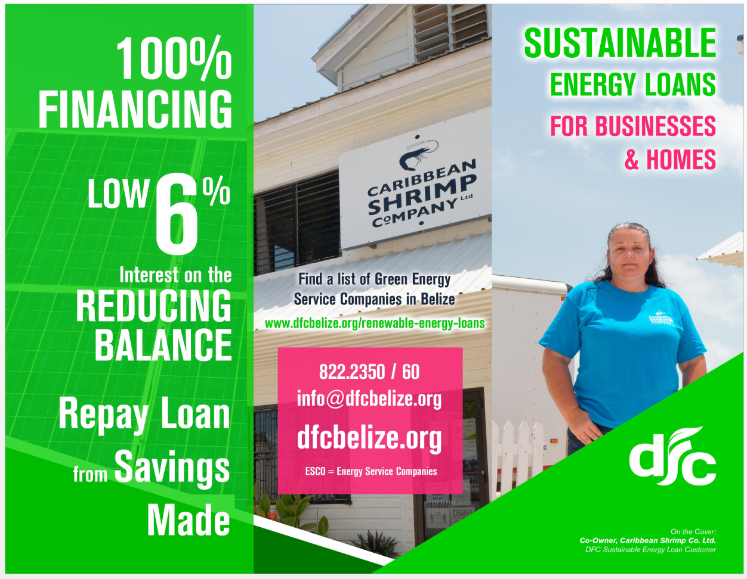

Slide 8
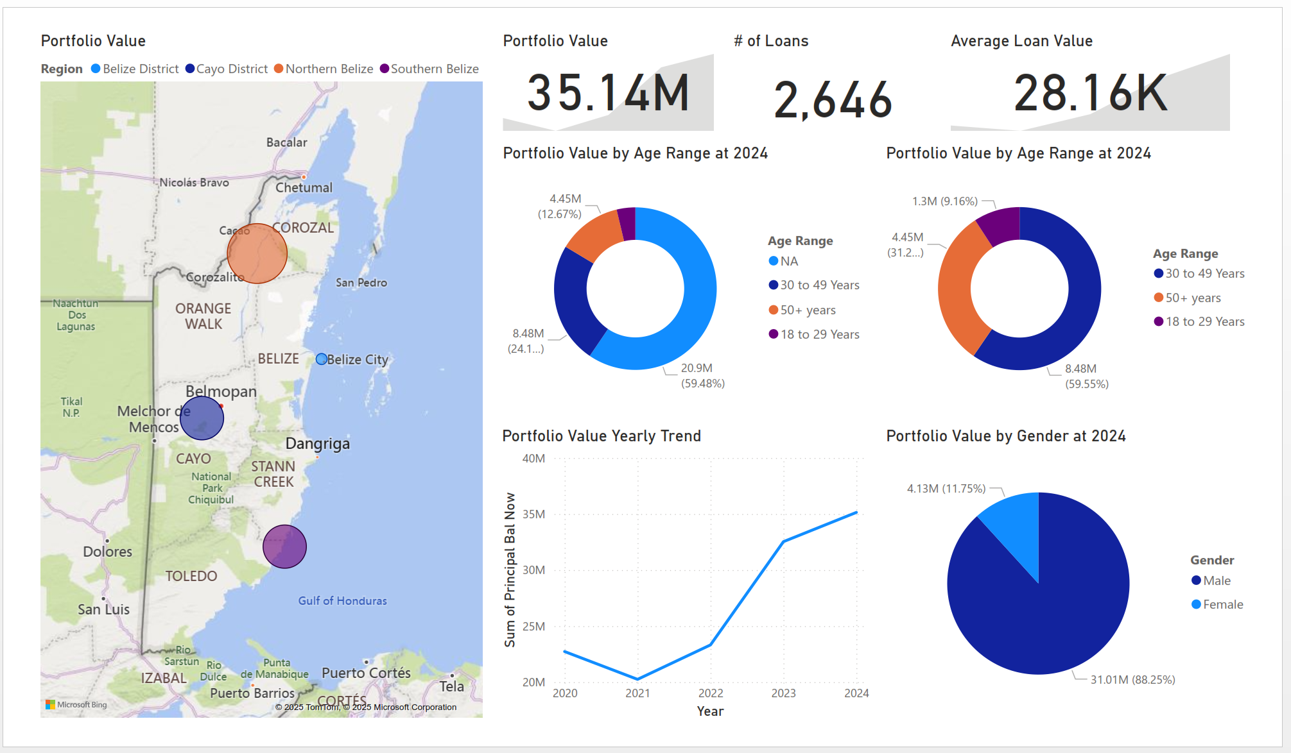

Slide 9
Next Practices
Leverage mobile payment system – Digi Wallet, E-cash
Omni Channels – digital tools
Climate Finance – GCF, Adaptation Fund
Electronic Collateral Registry
Insurance???
Measure Impact (MEALS)

Slide 10
Thanks
Any Questions

