Slide 1



WHY AND HOW PUBLIC DEVELOPMENT BANKS (PDB) CAN HELP RURAL FINANCIAL INCLUSION AND HOW TO DO IT
Carolina Trivelli

Slide 2
01.
KEY CONSIDERATIONS FOR FINANCIAL INCLUSION
02.
WHY IS IT RELEVANT FOR PDB?
03.
WHAT PDB IS DOING TO ADVANCE RURAL FI?
TABLE OF
CONTENT

Slide 3
01.
KEY CONSIDERATIONS FOR RURAL FINANCIAL INCLUSION

Slide 4
RURAL FINANCIAL INCLUSION
Rural populations, organizations and businesses involved in agriculture, and non-agricultural activities have access to and use affordable financial products and services that meet their needs, which are delivered in a responsible and sustainable way.
Financial inclusion drives economic growth, reduces poverty and inequality, and enhances human development at both micro and macro levels. It strengthens financial health, supports food security, and improves resilience to external shocks.

Slide 5
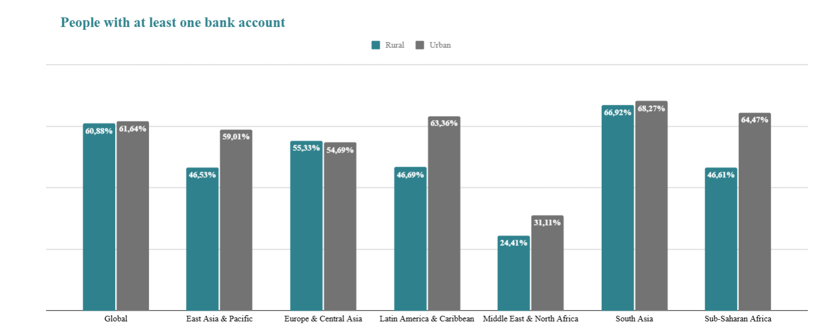
RURAL FINANCIAL INCLUSION TODAY
3/5
Latin America & Caribbean and Sub-Saharan Africa have the most significant disparities between urban and rural populations
people worldwide have at least one financial account.

Slide 6
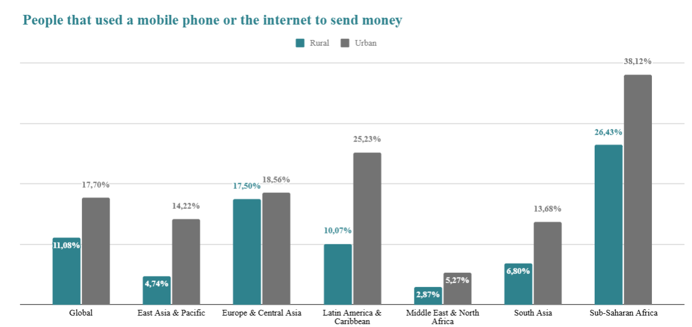
RURAL FINANCIAL INCLUSION TODAY
1/5
Latin America & Caribbean and Sub-Saharan Africa have the most significant disparities between urban and rural populations
people worldwide use their phone or internet to send money.

Slide 7
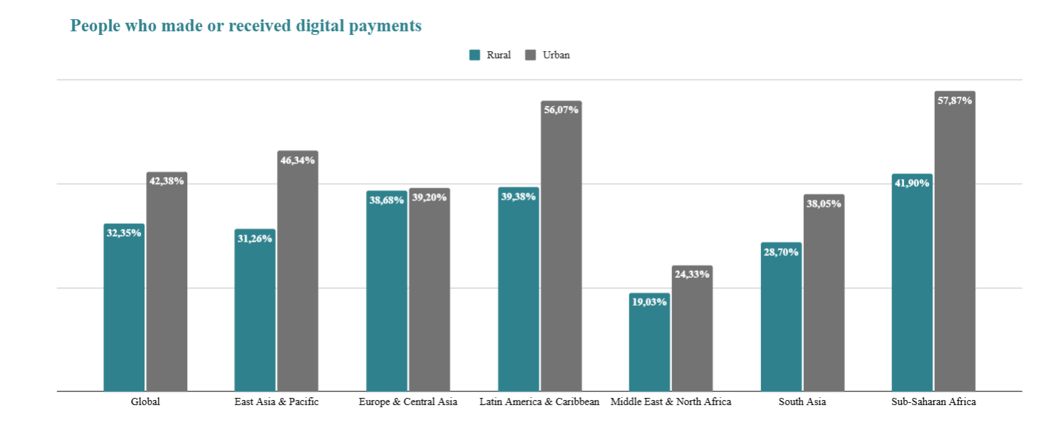
RURAL FINANCIAL INCLUSION TODAY
2/5
Latin America & Caribbean and Sub-Saharan Africa have the most significant disparities between urban and rural populations
people worldwide made or received a digital payment.

Slide 8
02.
WHY IS IT RELEVANT FOR PDB?

Slide 9
Why is rural financial inclusion a relevant goal for PDB?
  Despite its benefits, financial inclusion in rural areas remains lower than in urban settings. PDB play a crucial role in this context, acting as key credit providers for agriculture and serving as essential drivers for unlocking the economic potential of rural communities.
  Rural financial inclusion improves the economic ecosystem and expands livelihoods in the rural areas
  Rural financial inclusion allows clients to better perform
  Rural financial inclusion could help to reduce transaction costs and risks.

Slide 10
  PADB combine financial expertise, policy influence, and the ability to mobilize public resources.
  Their physical presence in rural areas makes them uniquely positioned to address local needs and expand access to financial services.
  Compared to microfinance institutions, PADBs are more effective in supporting long-term agricultural investments.
  When well-governed and commercially oriented, these institutions play a pivotal role in sustaining financial access, especially during periods of economic uncertainty.
The comparative advantage of PDB in supporting rural Financial Inclusion

Slide 11
03.
WHAT PDB ARE DOING TO ADVANCE RURAL FI?

Slide 12












Some promising examples
ÚNICA
Perú
BANK RAKYAT
Indonesia
FIRA
México
NIRSAL
Nigeria
CGAP, SAHAMANTI & IPPB INITIATIVE, NABARD, RRBs
India
FINAGRO
Colombia
TAMWIL EL FELLAH
Marruecos
GIRSAL
Ghana
BANCO DO NORDESTE
Brazil
BANRURAL S.A.
Guatemala
DFC
Belize
ARDB
Cambodia
.....among several other promising initiatives

Slide 13
THANK YOU

