Slide 1
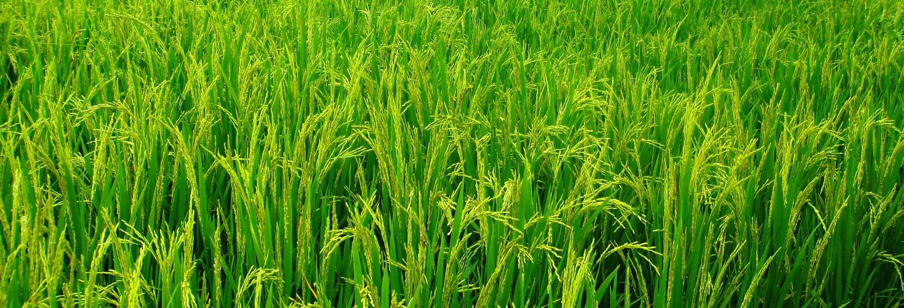
Rural Financial Inclusion for Sustainable Growth Localized Initiatives in Cambodia
Presented by: Panha KUY, Director of Business Strategy Development
Agricultural and Rural Development Bank
Date: 28-29 April 2025

Slide 2
Cambodia’s Rural Economy
Key Characteristics:
Around 75% of Cambodia’s population reside in rural areas and the majority depends on agriculture sector.
High poverty level is mostly observed in rural parts of the country.
Rural communities remain highly vulnerable to extreme weather events, particularly flooding, which disrupts both social and economic stability.
There are significant disparities in the roles of men and women, with traditional gender roles influencing economic participation and opportunities.
Many rural households have low levels of financial literacy, which restricts their ability to make informed financial decisions and manage cash flow risks.
Reference: World Bank Data, Rural Development Strategy, Action Plan 2019 – 2023

Slide 3
Current Credit Situations – 2 Main Sources of Finance
Formal Sources
Informal Sources
1
1
Banks (62)
Relatives
2
2
Microfinance Institutions (89)
Friends
3
3
Financial Leasing Institutions (13)
Neighbors
4
Although informal sources are more accessible than formal ones, lenders are exposed to high risks, including fluctuating interest rates and exploitation, as demonstrated in recent situations.
Moneylenders
Reference: National Bank of Cambodia as December 2024
Notes:
Difference between the 2
Formal
Large-scale loans for development
Regulated and structured
Accessibility challenges
Informal/Traditional Lenders
Quick access to funds
Flexible terms, but high interest
High risk of exploitation

Slide 4
Identifying Barriers to Rural Financial Inclusion
Limited Financial Infrastructure
Incomplete legal framework for financial products and consumer protections
Highly collateral based lending approach
Financial Literacy Constraints
18%
Of Cambodians are considered financial literate
135th
Rank of Cambodia in the Atlas and Standard & Poor’s Global Financial Literacy Survey
Fragmented lending
Only 59%
Of Cambodian adults aged over 18 have access to formal finance
68%
are adults in urban areas
55%
are adults in rural areas
Reference: Standard & Poor’s Ratings Services Global FinLit Survey, ADB, United Nations Capital Development Fund
Notes:
Incomplete legal framework for financial products

Slide 5
Example of ARDB’s Localized Initiatives
Enhancing Credit Accessibility Initiatives: ARDB has introduced several financial products to align with the smallholder farmers across the country such as credit to smallholder farmer, credit to agricultural cooperatives, and the credit to MSMEs in agriculture sector and agri-processing sector.
Promoting Financial Literacy Initiatives: ARDB has incorporated and mainstream the financial literacy to smallholder farmers through leveraging 2 mechanisms such as broadcasting and digital platform (Agri-App).
Digitalization Transformation Initiatives: Since transitioning from a specialized bank to a commercial bank, the Bank has embedded digital tools to expand financial service outreach. This includes not only a digitalized loan application process but also the integration of technology into everyday internal banking functions.

Slide 6
Collective Impacts of the Bank’s Initiatives

Slide 7
Driving Rural Financial Inclusion Through Key Partnerships and Innovations
Government: The government plays a crucial role in promoting rural financial inclusion by creating supportive policies, building, investing in financial literacy programs, and stimulus the private investment in supporting affordable financial services and boost rural entrepreneurship. innovation.
Private Sector: The private sector drives rural financial inclusion by expanding access to banking, credit, insurance, and digital financial services.
Development Agency: Development agencies support rural financial inclusion by providing funding, technical assistance, and policy advice.
Collaboration is critical to enhance the collective and significant impacts for rural communities

Slide 8
ដើម្បីកសិករនិងអភិវឌ្ឍន៍សេដ្ឋកិច្ចសង្គម
បន
សូមអរគុណ​!​​
Thank you!

